Slide 1
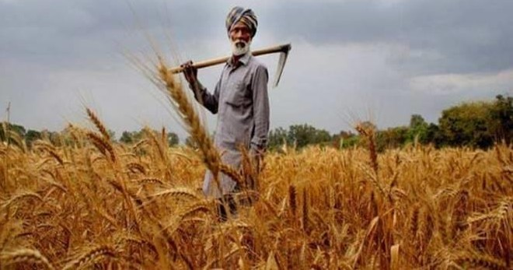
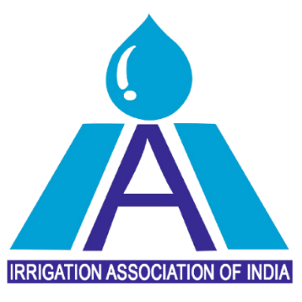
Role of Industry in Promoting Micro Irrigation Systems
31st May 2023
New Delhi

Slide 2
Topic
Potential of Micro irrigation
Impact of Micro Irrigation
Challenges and Solutions

Slide 3
Potential of Micro irrigation

Slide 4
Evolution of Micro Irrigation scheme in India
Sprinkler irrigation was part of the Green Revolution in 1960s and 1970s
Centrally Sponsored Scheme on Micro Irrigation
Rural Infrastructure Fund
National Mission on Micro-Irrigation
Pradhan Mantari Krishi Sinchayee Yojana
ISOPOM
1954
1995
2004
2006
2010
2015
1992
1996
2005
2007
2014
Centrally sponsored scheme on use of plasticulture in agriculture
Accelerated Irrigation Benefit Program
National Horticulture Mission
National Mission on Sustainable Agriculture
RKVY & NFSM
4

Slide 5
Advent of “Per Drop More Crop” in 2015 - “Acche Din” for Farmers
PMKSY comes into being in 2015 with exclusive scheme for MI came into being as “ Per Drop More Crop”
Per Drop, More Crop
Pradhan Mantri Krishi Sinchayee Yojana
Har Khet ko Paani
With vision of 1 cr Ha. Micro irrigation coverage in 5 years, it is one of the key emphasis for doubling farmer income
Scheme for Enhancing MI Coverage

Slide 6
The Indian Micro-Irrigation Potential
Currently low penetration rate for micro-irrigation represents enormous potential
Potential
Highlights
India is the largest user of groundwater in the world, consuming ~230 km³ annually (more than 25% of the world)
54% of India faces high to extreme water stress
More than 85% of underground water is consumed for agriculture
India’s irrigation efficiency at 38% compared to 50-60% in OECD countries
Government targets to achieve 10MHa in next five years, which still leaves us with 46 mHa
Gross Cropped Area 198m Ha
Drip
6m Ha
Net Cropped Area 142m Ha
Micro-Irrigation
12.4m Ha
Micro-Irrigation Potential Area
72.17m Ha
Only ~8% of the potential area is drip-irrigated
GAP = 78-80%
15.81% of the total micro irrigation potential in the country is realized by the year 2018
Source: Weather.com
Note: Gross Cropped Area refers to multiple crops grown during the year on the same plot of land. 000
Reference – Policy Paper by ICAR
1: Potential area is been estimated by using proportion of area irrigated by groundwater, tank and 30% of canal irrigated area

Slide 7
Net Irrigated vs Micro Irrigated Area
Out of the total Net Irrigated Area of 72 mHa only 7.8 mHa is covered by MIS under PMKSY (2015-present) which is 11% . There is an enormous potential for MI industry to explore, expand and benefit.
Potential area which could be brought under MIS is estimated as 72-77 mha

Slide 8
Crop-Wise Potential Area of Micro Irrigation in India (Area in Lac Ha)
Cereals 470.0
Flowers, Medicinal & Aromatic
2.0
Oil Seeds
58.0
Fruits & Vegetable 49.5
Pulses
36.0
Sugarcane 55.6
Spices & Condiments 2.15
Coconut, Plantation & Oil palm 6.5
Cotton
32.5
Others
32.0
Notes:
Pse convert to lakh ha

Slide 9
Impact of Micro Irrigation

Slide 10
Micro Irrigation Industry – Impact
Farmers Benefited
10 million +
Saving on Labour Cost
30-40%
Employment Generated
50,000 +
With every 10 Ha of land is irrigated, employment increases from 8 to 24 persons
We ALSO Save WATER
40%
Fertilizer Saving
28.5%
Increase in Yield/Productivity
Fruit/Crops – 42.4%
Vegetables – 52.7%
Energy Saving
30.5%
Increase in Farmer’s Income
42%
Study by IAI, FICCI & Grant Thornton

Slide 11
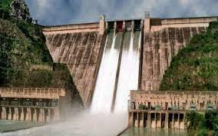
Micro Irrigation – Save Water
Arable Area
142 million Hectare
Net Irrigated Area
69 million Hectare
Micro Irrigated Area
7 million Hectare
(since the Inception of PMKSY (2015-23)
Saving 6 times the capacity of Bhakra Nangal Dam
(260 TMC)
PROJECTED WATER SAVING
With additional coverage of 10 million Ha (2023-28)
2100 TMC
Water Saved
1500 TMC

Slide 12
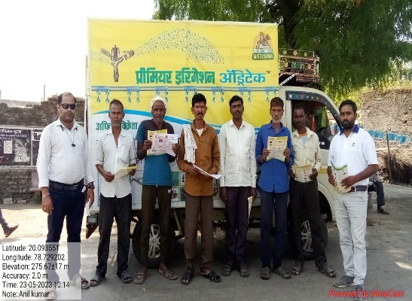
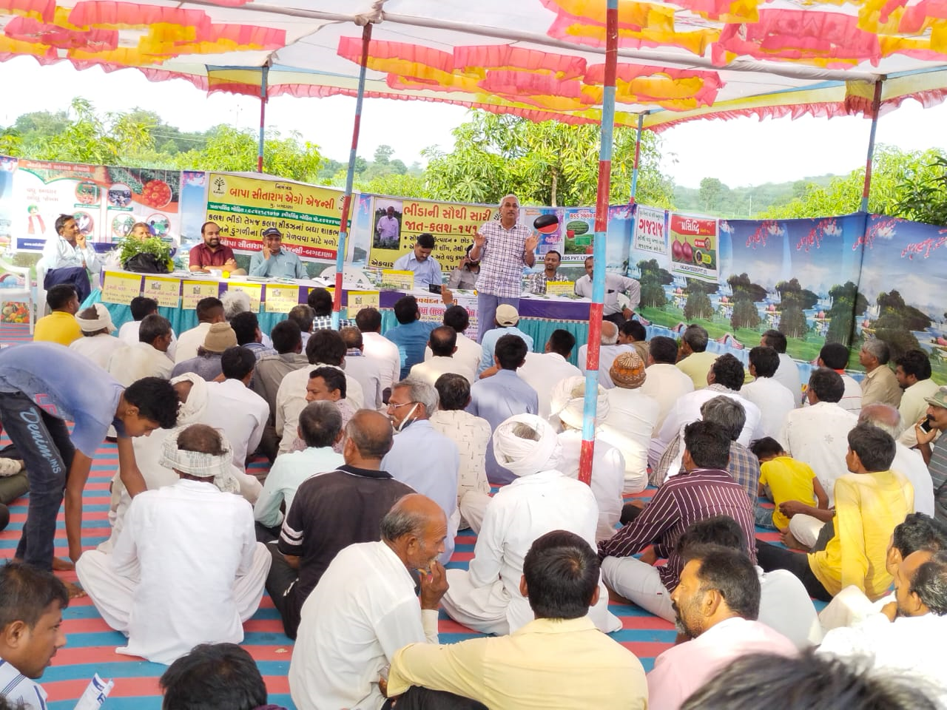
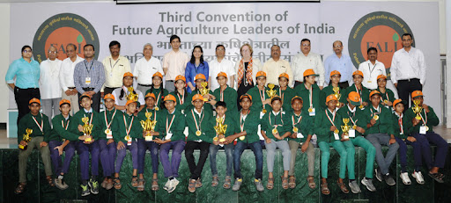
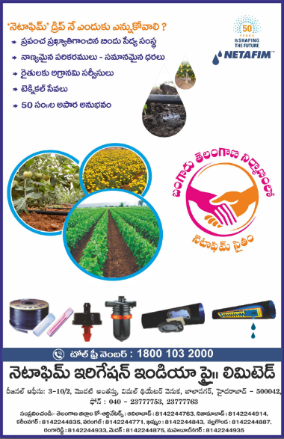
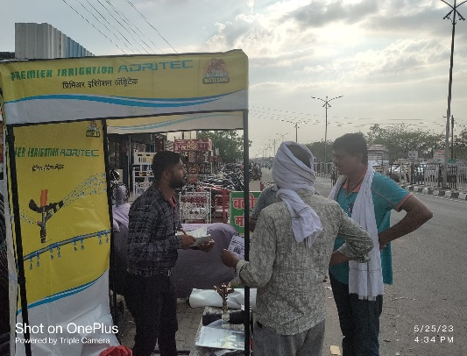
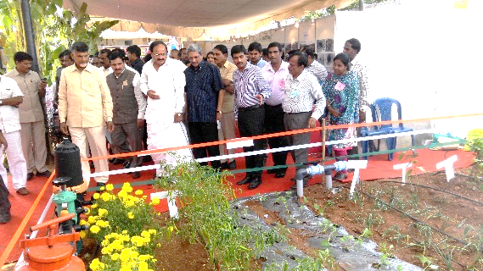
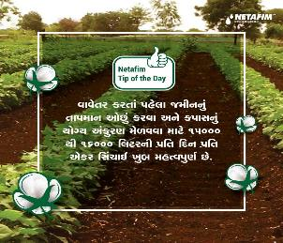
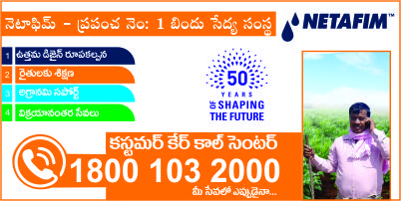
The all Encompassing Role of MI Companies
Van Campaign
Farmer Meeting
Youth Training
Wall Painting
Newspaper Adv.
Crop Webinars
Canopy
Exhibitions
Knowledge Tips
Call Centre
Integration & involvement of MI companies is much more than just selling product
12

Slide 13
Micro Irrigation Industry
Aatamnirbhar Bharat
300 + Companies
Skill Development
MSME: > 95%
Make in India
Capacity Utilization < 50%
Rural Agripreneur

Slide 14
Challenges & Solutions

Slide 15
Area covered under MIS since the inception of PMKSY is 77.8 Lac Ha
CAGR -2.84%
CAGR 20.35%
1%
11%
3%
25%
-20%
8%
52%
% Growth
Notes:
Give total and area converted in Lakh ha

Slide 16
Sate wise Coverage of PMKSY (FY 16 to FY 23)
Micro Irrigation
Karnataka, Maharashtra, Tamil Nadu, Gujarat, Andhra Pradesh, Rajasthan constitutes 80% share

Slide 17
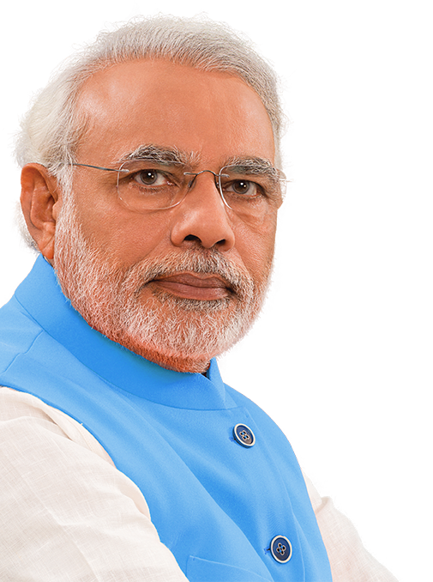
Vision | Drivers | Game changers
Game Changer
Critical drivers
Appointment of Project Management Agency
Updation of PDMC guidelines
Fortnightly state review and monthly GOI stewardship council review
Transparent online portal
Dedicated manpower
12-month operation
Timely disbursement of subsidy
Time bound activity
Vision: 20 Lakh Ha Per Year under MI

Slide 18
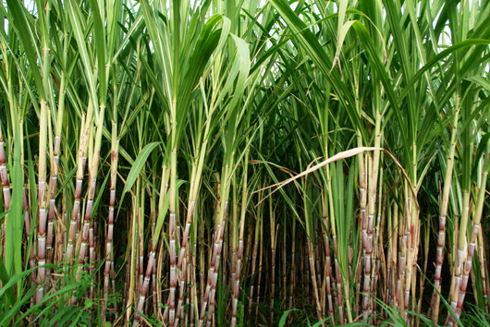
Game Changer- 6. Crop focus: Sugarcane
Total sugarcane area in India : 55.65 L ha with 800+ sugar mills
Major Grown state -UP-23.95 L ha, MH-12.32 L ha, KN-5.69 L ha
Sugarcane is the 2nd highest water consuming crop after Paddy
It consume around 25-30% of total water use in Agriculture
MI
Company
Collaboration to Promote MI
Sugar Mills
Bank/
NBFC
https://iisr.icar.gov.in/iisr/download/publications/extensionbulletin/microirrigationinsugarcane-english.pdf
https://agricoop.gov.in/sites/default/files/crops%20%281%29_1.pdf

Slide 19
Game Changer- 6. Crop focus: Oil Palm
Edible oil consumption in India is 24.35 million tons in F23 ( India Imports 14.38 million tons, where as Palm oil imports 9.17 million tons , around 64% of total Edible oil imports)
28 lac ha ( 9.62 lac ha in NE ) potential area for palm cultivation.
3.69 lac ha under cultivation ( 1.8 lakh ha is under fruiting)
Major states are TG , AP , CG , KN , KL , OD , GUJ , TN & NE ( Arunachal , MZ , NG )
Oil Palm yield 5 times more than traditional Oilseeds.
Perennial crop with 30 plus years of harvest
Requires from 200 to 300 litres of water per day
MI
Company
Update PDMC guidelines + Collaborate
Palm oil Factory
Implementing Agency
Update PDMC guidelines in oil palm to include Intercrop without which oil palm may not be viable
2. https://horticulture.tg.nic.in/OilPalm/Downloads/NFSMOilPalmImpGuidelines.pdf
1. https://nmeo.dac.gov.in/NMEOUploadDocuments/BriefNMEOOPRoI_05052022_637873526665916004_OilPalm_India_Brief.pdf
3. https://www.cnbctv18.com/business/india-import-edible-oils-consumption-16106231.htm

Slide 20
Game Changer- 7. FPO connect
Number of FPOs registered by respective agencies-7059
Small Farmers' Agri-Business Consortium (SFAC)-898
NABARD- 3904
FPOs registered by IAs under Central Sector Scheme (CSS) for formation & Promotion of 10,000 FPOs - 2257
On Spot Registration
The major role of FPO in India nowadays
Access to quality inputs
Market linkages
Technical assistance
Credit
Promoting sustainable agriculture
Empowering women farmers
Alleviating poverty
FPO
(Admin Cost)
Strengthen the FPO for MI Technical Services
Awareness Campaign to Cover FPO into MI in a Year
https://pib.gov.in/PressReleaseIframePage.aspx?PRID=1806232#:~:text=Further%20under%20the%20new%20FPO,2022.
20

Slide 21
Game Changer- 8. Expand PDMC to all states
Six states account for approx. 80% of annual coverage under PDMC
The opportunity to expand across others states, espy NE, is huge..
Northeast State Area coverage under MI
Use of Agri Data Stack
Digital Campaign
State | Net Sown Area ( 000’ ha ) | % Area under MI
Tripura | 255 | 0.1%
Sikkim | 77 | 2.3%
Nagaland | 384 | 0.1%
Meghalaya | 245 | 0.1%
Mizoram | 145 | 0.1%
Manipur | 437 | 0.2%
Assam | 2801 | 1.5%
Arunachal Pradesh | 227 | 0.1%
Workshops with all stakeholders
Awareness Conference
Accelerate states with low penetration
Cluster & Crop based approach
Farmers Training Program
21

Slide 22
Game Changer- 9. PM KUSUM & PDMC convergence
More than 5 Lac farmers have benefitted from PM- KUSUM scheme
Coverage in FY 22-23 was 1.46 lac Pumps.. Cost per pump is 3 to 5 lacs
Need to conserve water created with such cost..
PDMC may be made compulsory
Examples of convergence in Gujarat of new pump connections have been successful
PM- KUSUM
Mandatory MI
Service & Training
Down stream integration
Collaboration
1. https://pib.gov.in/PressReleasePage.aspx?PRID=1909267
2. https://mnre.gov.in/img/documents/uploads/file_s-1650960108170.pdf

Slide 23
Game Changer- 10. Pressurized Distribution Network (PDN)
Creating a right policy for PDN can disrupt the entire ecosystem
Under Jal Shakti, a large number of PDN projects have been awarded and some executed
Much of it is in MP and Odisha (> 3 lac ha in operation)
While these projects, water is meant to be used by Micro Irrigation, less than 5% area is under MI
Standardised BoQ | Simplified guidelines to ease adoption
Pilots for over 50k ha in FY 23-24
Formation of a working group, comprising of Govt and Industry experts
One of the major reason for low penetration is the areas are very large compared with state AAP for PDMC and also Govt agencies are different

Slide 24
Thank You
24

Slide 25
Game Changer- 10. MI Coverage for Landless and lease Farmers
01
03
Leased Land
Leased Land
Contract Farming
Total Cultivated land
Total Cultivated land
Landless Farmers
02
04
The total cultivated land in India approx. -159.7 mHa
13% of Land is leased in India approx. 20 mHa
44 million landless agricultural workers - about 39% of the total agricultural workforce
Total contract farming area approx. 10 million hectares. About 06% of the total agricultural land
The 2011 census & The National Sample Survey Office (NSSO)
https://india.mongabay.com/2023/01/climate-change-vulnerabilities-pushing-landless-farmers-to-the-brink/#:~:text=According%20to%20the%20National%20Statistical,cultivable%20land%20of%20the%20country.

