Slide 1
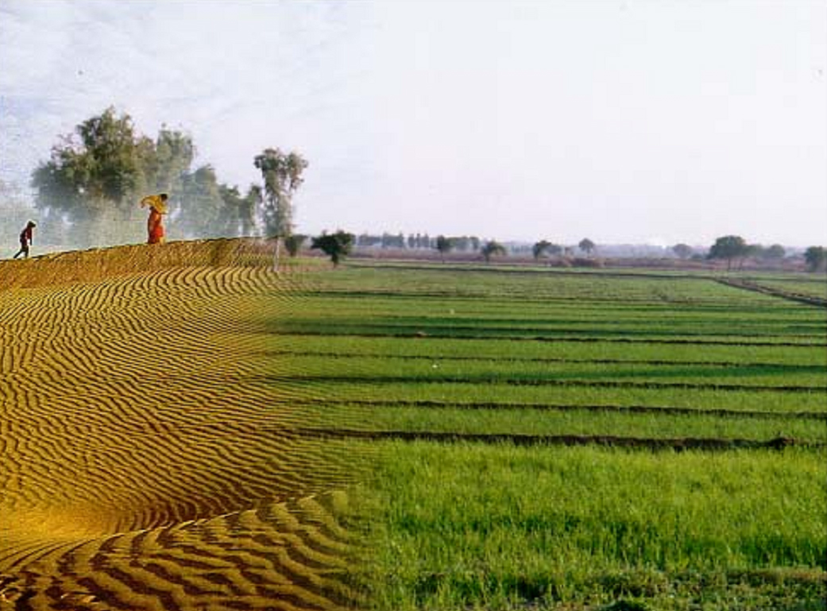
Welcome
PDMC: Micro Irrigation
31.05.2023
Department of Horticulture Government of Rajasthan

Slide 2
Notes:
Climate varies from arid to humid.
Aravali mountain range divides the state diagonally.
Western part is arid.
Indira Gandhi canal has dawned an era of prosperity in western Rajasthan.

Slide 3
State Micro Irrigation scenario
Country’s area 10.5 % while water resource 1.1 %
Net cultivated area 181.69 lac ha
Net irrigated area 82.57 lac ha
Area under Micro Irrigation 18.00 lac ha
Potential for Micro Irrigation 64.57 lac ha
Well & Tube Well Irrig. Area : 73%
Canal Irrigated Area : 26%
Water share for irrigation : >85%
Irrigation efficiency (Sandy soils) : 25-40%
Rajasthan stands :
Country’s major stake in area coverage under Sprinkler.

Slide 4
Micro Irrigation Progress: Rajasthan

Slide 5
Micro Irrigation Growth: Rajasthan
Rajasthan
Year | Growth %
2019-20 | 8.50
2020-21 | 18.13
2021-22 | 34.46
2022-23 | 105.31

Slide 6
District Micro Irrigation scenario: Percent of Irrigated
> 51% | 4 | Rjs, Jlr, Jpr, Skr
41-50% | 1 | Brm
31-40% | 3 | Bhl, Ctr, Ajm
21-30% | 8 | Srh, Chr, Jjn, Jdp, Dau,Bkn, Prt, Ngr
11-20% | 9 | Jhl, Udr, Alw, Hmg, SM, Dun,Jsl,Ton, Pal
<10% | 8 | Bns, Kot, Bun, Gng, Krl, Dhl, Brn, Brt

Slide 7
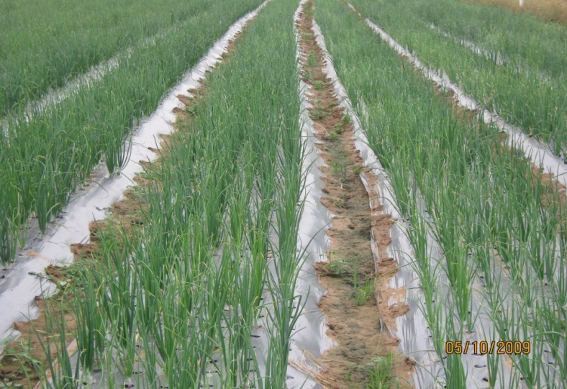
Progress
Physical & Financial progress 2022-23
Component | Phy (ha)
 | Targets | Achievement | Remarks
Drip+ Mini Sprinkler | 66,425 | 69,616
Sprinkler | 1,33,619 | 1,21,389
G. Total | 2,00,042 | 1,91,004
Component | Financial (Rs. In Cr.)
 | Targets | Achievement | Remarks
MI (CA+SS) | 487.60 | 301.12
MI (Adl SS) | 194.41 | 196.50
G. Total | 682.01 | 497.62

Slide 8
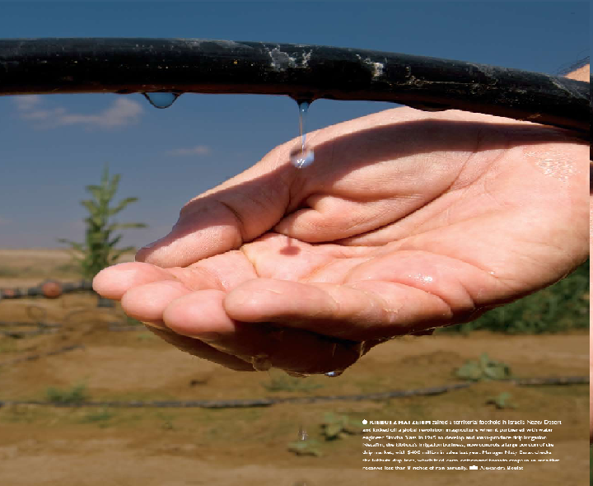
Annual Action Plan (AAP) 2023-24
Amount in Rs cr.
Phy (ha) | Central Share | State Share | Addl. SS | Total
2,25,045 | 329.13 | 219.42 | 218.71 | 767.26
CA+SS =548.55

Slide 9
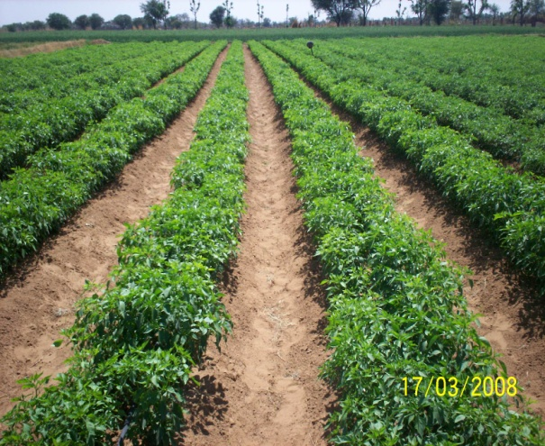
PMKSY: Assistance Pattern
SF/ MF/ SC/ ST/ Female-75%
Other- 70%
Component | Pattern
 | Category | GOI Norm (60:40) | Addl. | Total
Micro irrigation systems | Small/ Marginal Farmers | 55 | 20 | 75
 | SC/ ST/ Woman | 45/ 55 | 30/20 | 75
 | Others | 45 | 25 | 70
State promotes the micro irrigation by providing additional assistance to the tune of 20-30 %

Slide 10
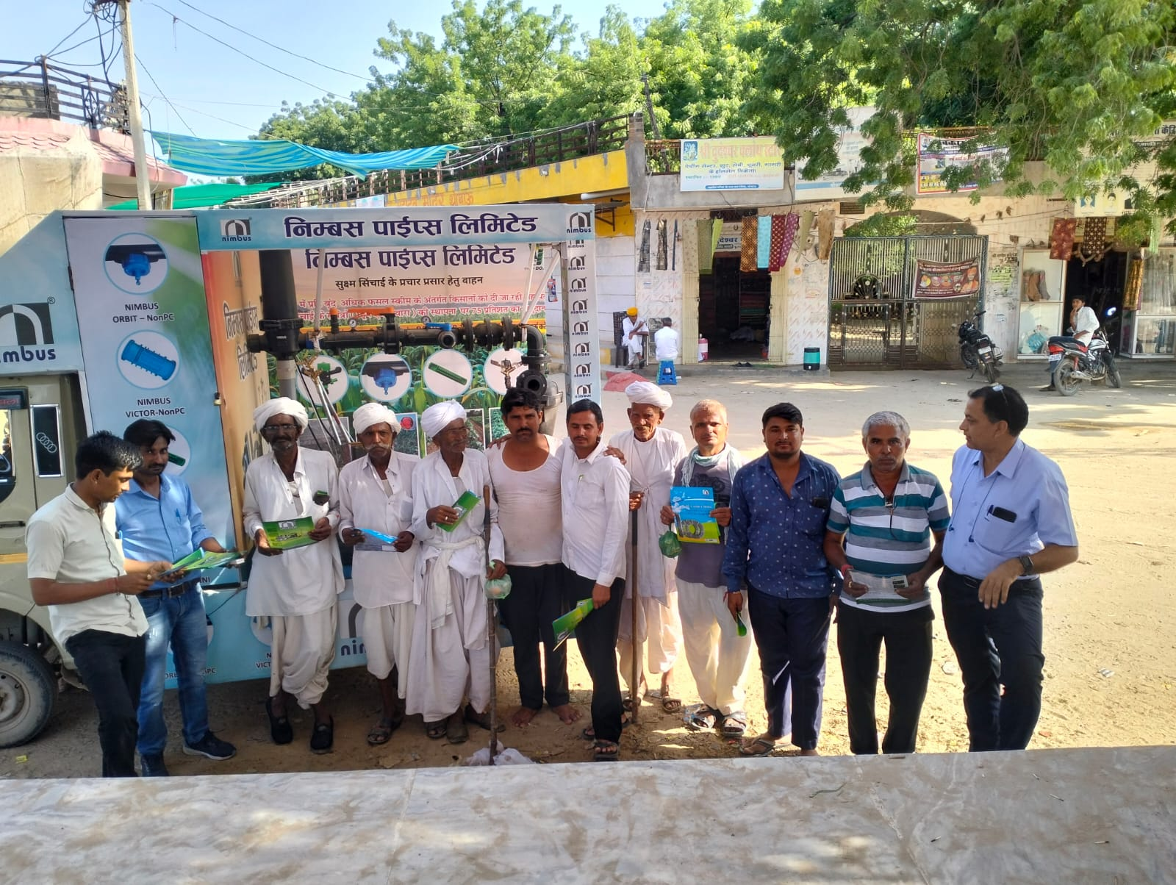
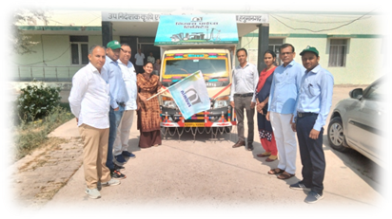
Implementation strategy
Convergence
MI integrated compulsorily with NHM (orchards, WHS), Solar Pumping program, Agri. Farm Ponds/ Diggies
Other Departmental Schemes- Atal Bhujal Yojana, RWSLIP (JICA)
Strong Supply Network
MI Manufacturer-176, Authorised dealers-10k
End to End Digitization: Rajkisan Saathi Portal
Dedicated portal for Agriculture and allied schemes
Janadhar and SSO based authentication
Online sanctions, verifications and payments
Campaigns
Special campaign (16 Aug to 30 Sept. 2022) 855 events, 2.30 lac applications
Prashasan Gaon ke sangh
Active involvement of Policy makers

Slide 11
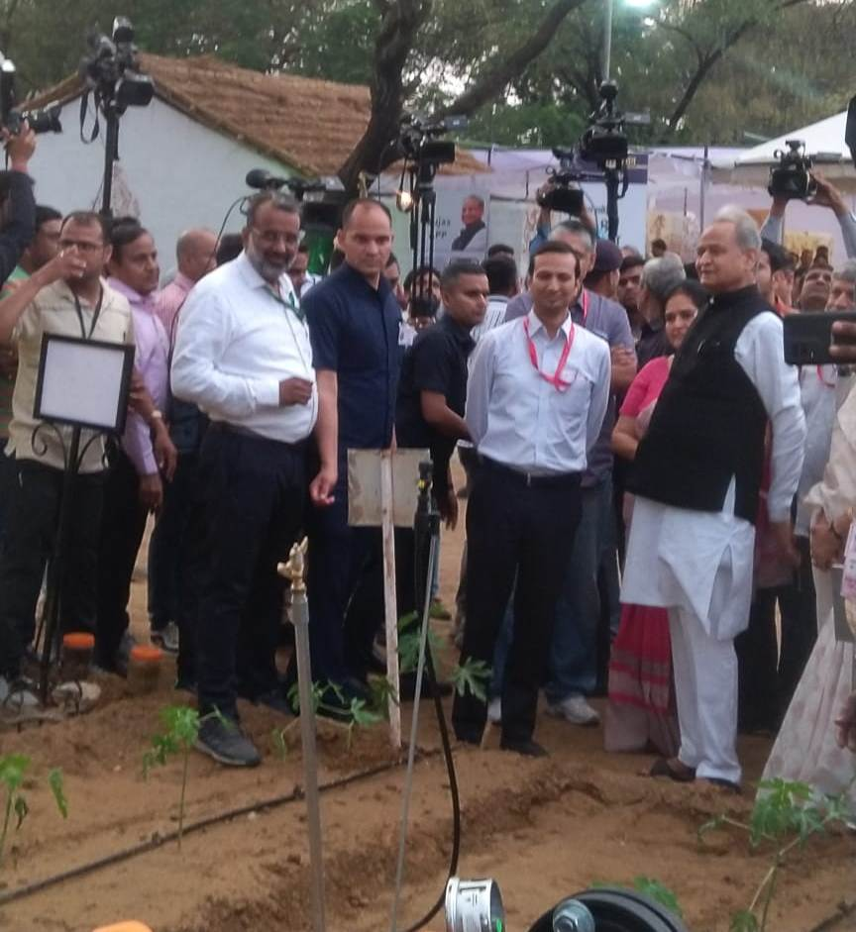
Micro Irrigation: The State Priority
Agriculture Budget Rajasthan 2022-23 provided the first priority to Micro Irrigation and announced
Rajasthan Micro Irrigation Mission

Slide 12
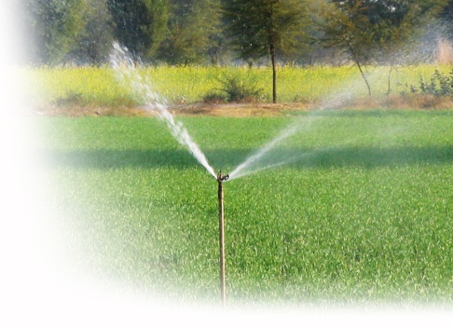
Micro Irrigation: The State Priority
Brief of 5 year Budget Announcements
Year | BA No. | Brief of BA | Area (lac ha) | Beneficiary (lac Nos.) | Amount (Rs. Cr)
2019-20 | 21 | Fertigation, Automation, Foliar Fertilization
2020-21 | 34 | Additional area under MI (Drip, Sprinkler) | 0.30 |  | 91.00
 | 120 | Priority of electric connection for drip
2021-22 | 70 | Krishak Kalyan Kosh: Sprinkler & Mini Sprinkler |  | 1.20
 | 71 | Additional area under MI (Drip, Sprinkler) & promotion of fertigation/ Automation | 4.30 |  | 732.00
2022-23 |  | Agriculture Budget (separate)
 | 133 | Rajasthan Micro Irrigation Mission (Announced) |  | 5.00 | 2700.00
 | I | Drip/ Sprinkler promotion 3 yr |  | 4.00 | 1705.00
 | III | CoE Micro Irrigation 7 Div HQ |  |  | 35.00
2023-24 | 166-1-V | Complete coverage of 25 Blocks/ clusters under MI |  |  | 275.00
 | Reply 60 | New generation technology- Auto sensors & Fertigation |  | 0.10
 | Reply 69 | Dholpur Lift Irrigation: Micro Irrigation | 0.29 | 0.15 | 177.00
MIF- Rs. 765 cr (Rs.1922 cr Project cost)

Slide 13
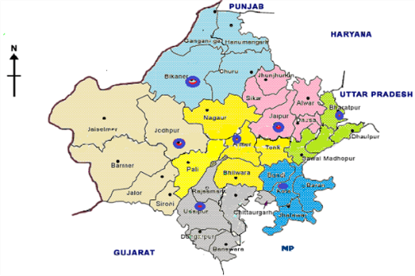
Implementation strategy
Integration of technologies
To synergize the program state govt. has made special initiative on:
Fertigation Program
MI Automation Program
Foliar Fertilization Program
Centre of Excellence for MI
The innovation & technical back- CoE Micro Irrigation at all 7 divisions

Slide 14
Issues:
Single factor affecting the movement
Payment cycle
Deviation proposed in existing guidelines
Periodic revision of Unit costs.
BOQ updates for drip and sprinkler.
Drip spacing of 1.0 x 0.30.
Automation and fertigation.

Slide 15
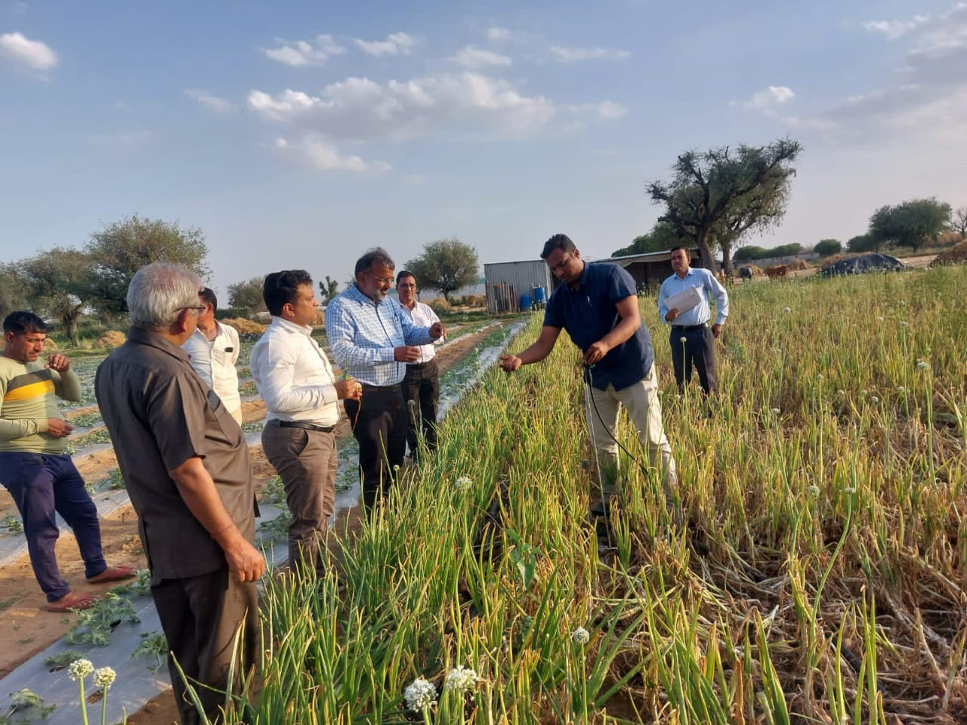
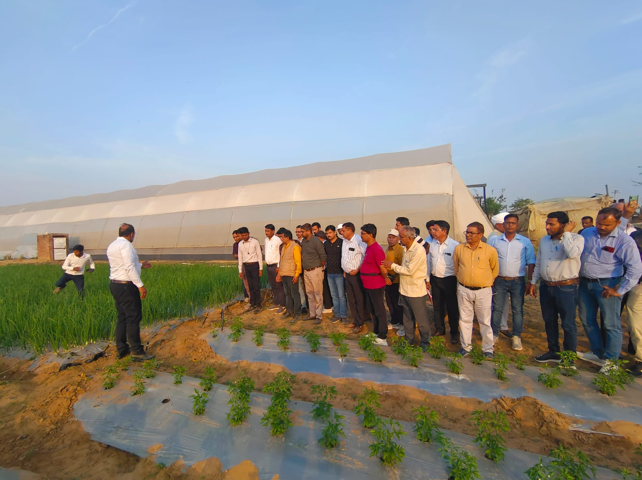
Success Story: Complete Saturated Village
Success Story- Begas Basedi Cluster, Bagru-Dudu (Jaipur)
(Known to be Mini Israel)
Micro Irrigation dovetailed with hi-tech horticulture activities
More than 300 Poly houses mostly combined with farm ponds
Successful Models:
1. Poly houses (cucumber) + Farm Ponds + Micro Irrigation+ Fertigation
2. Vegetables + Mulching/ low tunnels + Micro Irrigation + Fertigation
3. Water melon + Low tunnel+ Drip Irrigation + Fertigation
4. Mini Sprinklers + Pea/ Ground nut
https://drive.google.com/drive/folders/1UNU1fVdvYrz7Lvv584Z5JXe65uc34vFX

Slide 16
Replication of the success model
Micro Irrigation Fund (MIF)- 3 yr
Project Proposals 1922 cr.
MIF funds 765 cr.
Proposed Area 4.29 lac ha
Complete coverage in 25 clusters- 1 lac ha,
Top up assistance – 3 lac ha,
Dholpur lift canal- 0.29 lac ha
Focus on dark zones/ severely affected ground water clusters
Community Participation at GP level by nominating AWA (Agri. Water Ambassadors) and incentivize the on MI coverage basis
Special provisions for training and technical strengthening
Dedicated professionals to be placed at cluster and district level for monitoring and execution

Slide 17
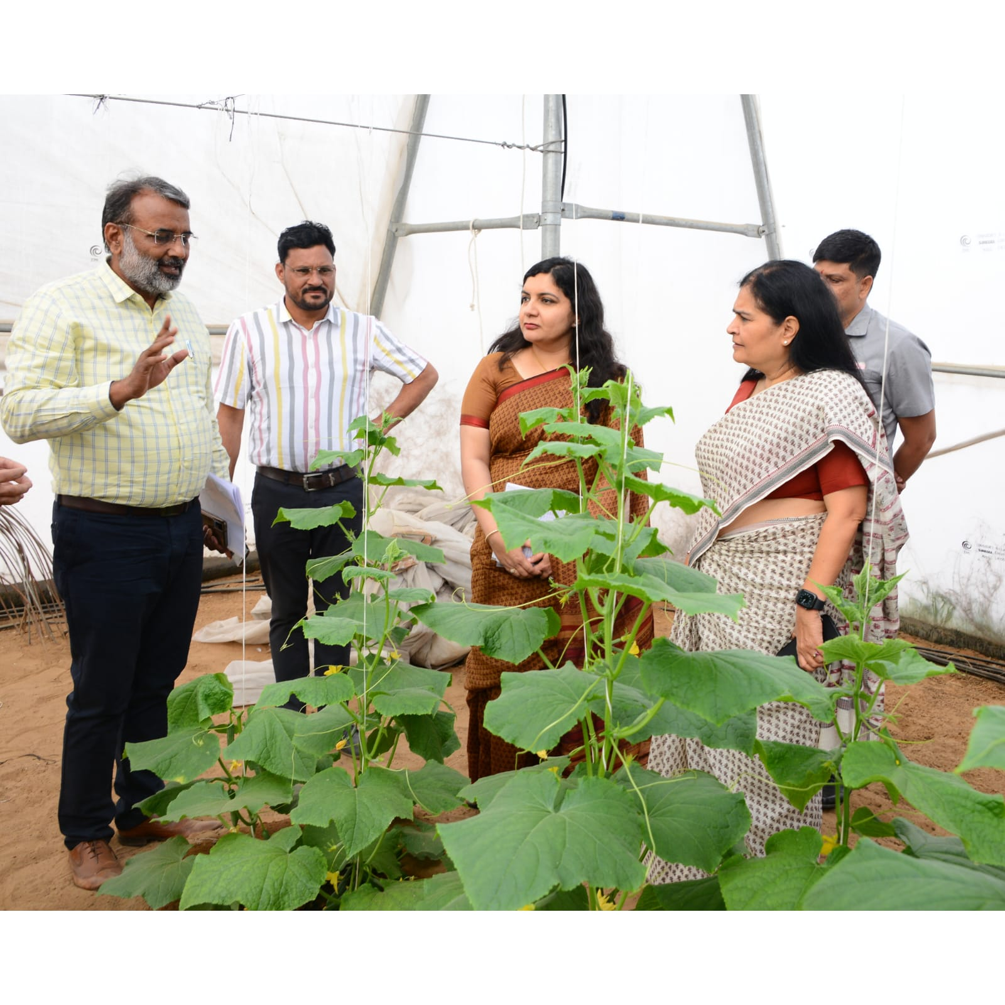
THANK YOU

