Slide 1
Agriculture and Farmer’s Welfare Department, TamilNadu TAMILNADU HORTICULTURE DEVELOPMENT AGENCY (TANHODA)

Slide 3
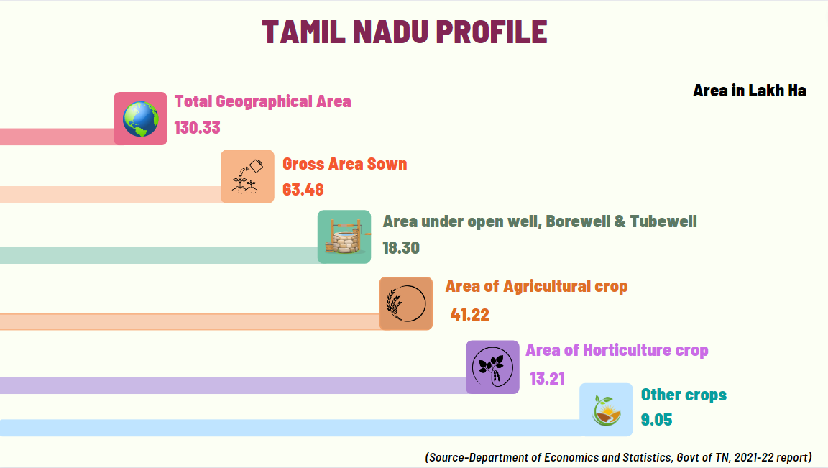

Slide 7
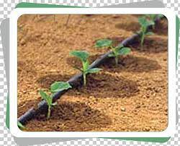
Modus Operandi @ DISTRICT LEVEL
JDH / DDH District
District Implementation officer
Block AD
Implementing Officer in Block Level
HO / AO (Block level)
Assisting Block AD &
Monitoring AHOs & AAOs
AHO / AAO
Execution at Village Level
Farmers
Registration Online

Slide 8
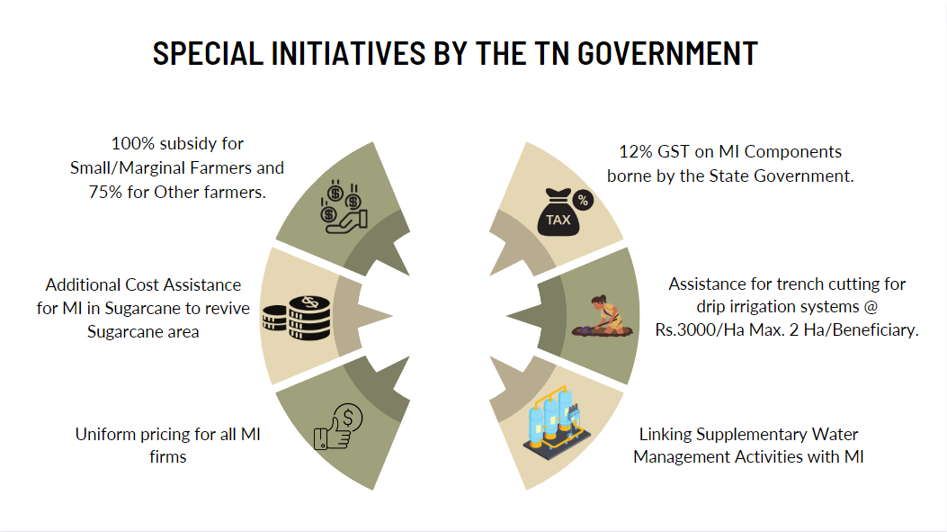

Slide 9
SUCCESSFUL STRATEGIES Of TAMILNADU
Frequent Review meetings
Rapid release of funds
Exclusive Portal –”MIMIS”
Interlinking MI with SWMA
Village level campaigns
Subsidy pattern

Slide 11
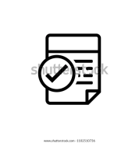
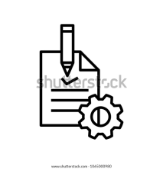
Process Flow of Micro Irrigation
Application Registration by Farmer/BLO/MI firms
Approval of quotation
Work Order Issuance by BLO
Scrutiny and Approval of Application by BLO
MI System Installation by MI Firms
Joint Inspection
(Horti/Agri &AED)
40% Fund Release - District officers
Layout and Quotation preparation by MI Companies in consultation with farmers
60% Fund release by State Head Quarters
Quality check, service & Feedback
Micro Irrigation Through MIMIS

Slide 13
Contd…

Slide 14
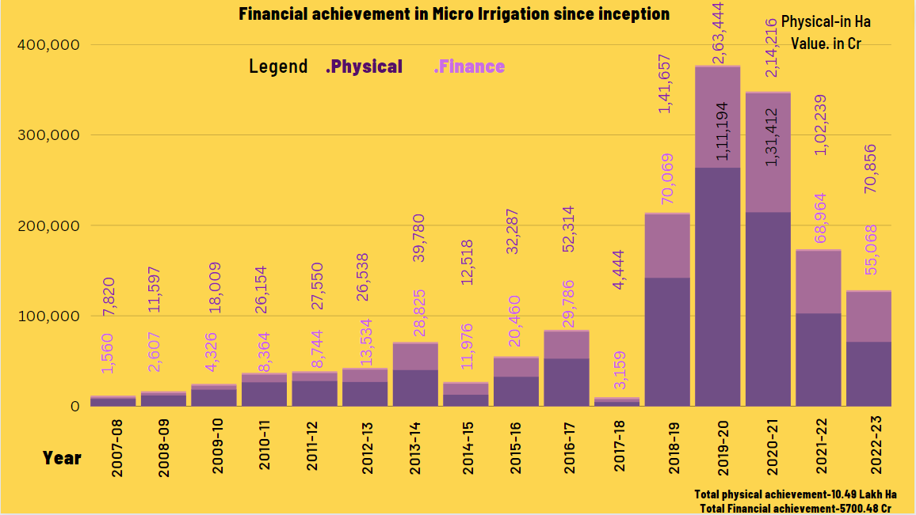

Slide 19
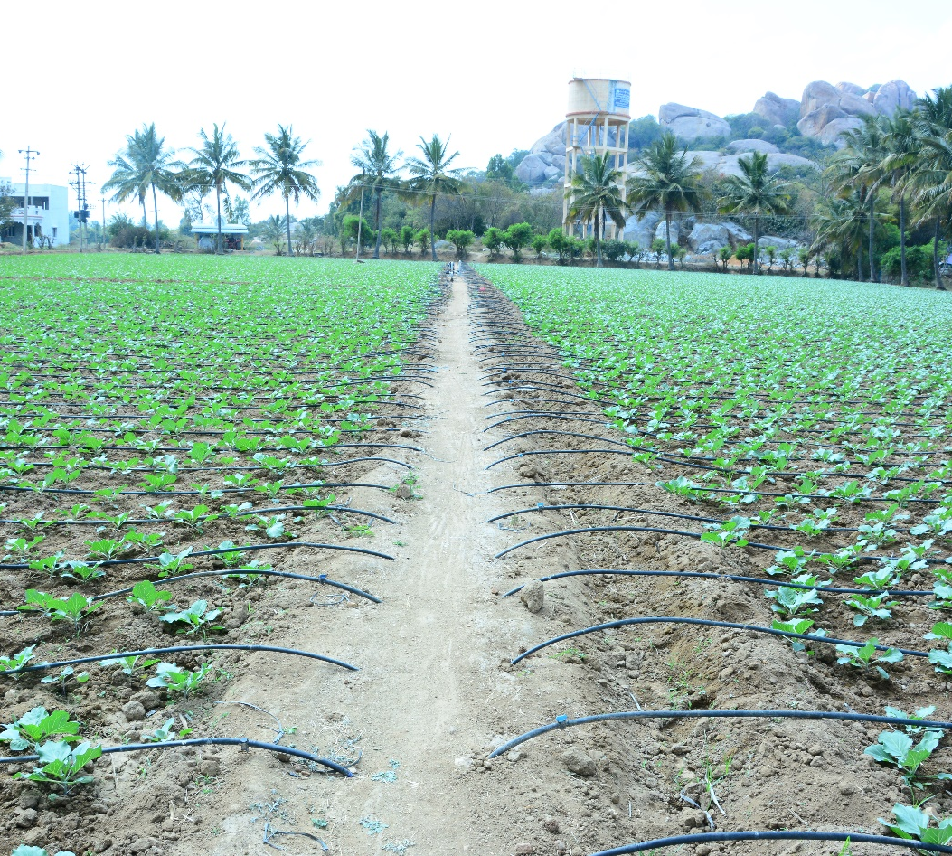
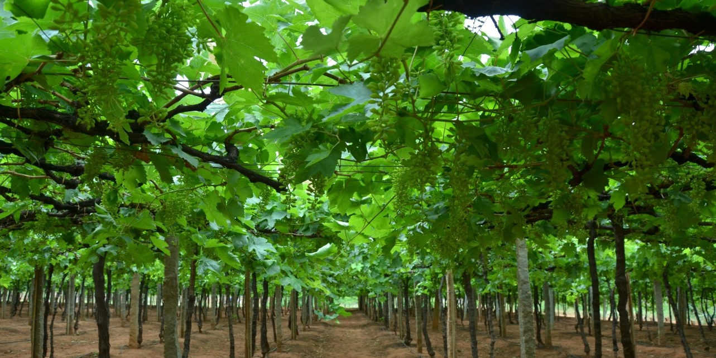
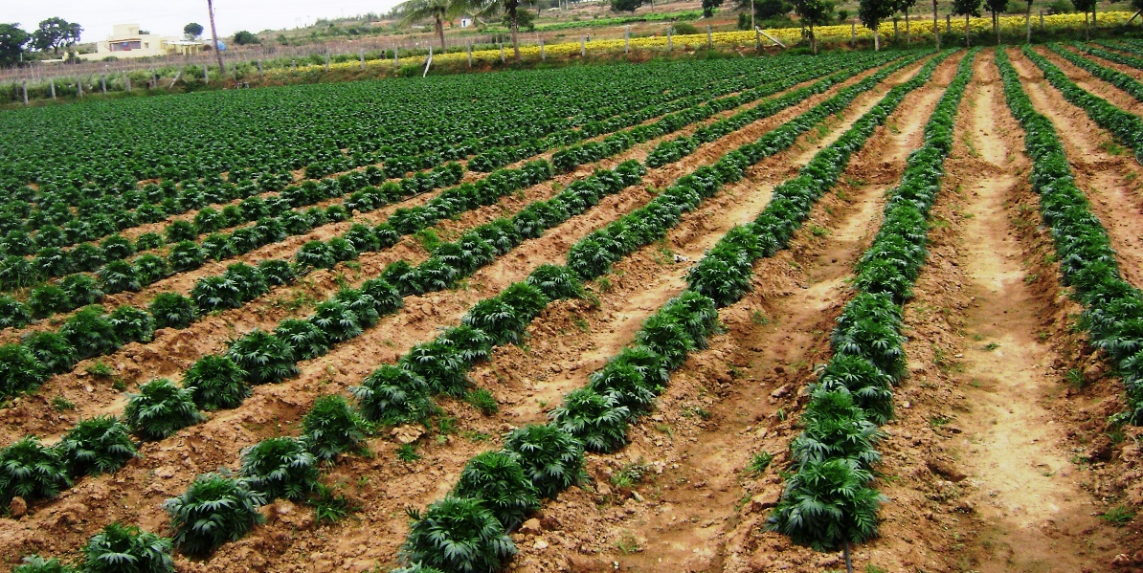
IMPLEMENTATION PHOTOS

Slide 20
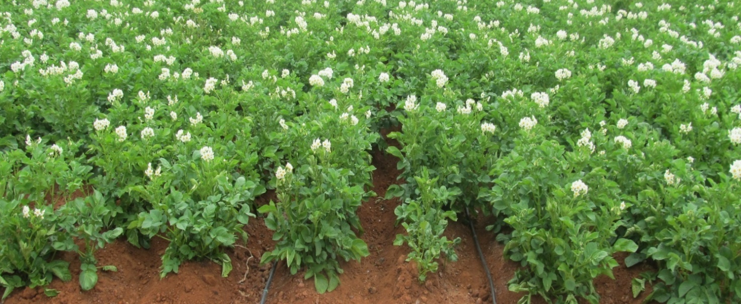
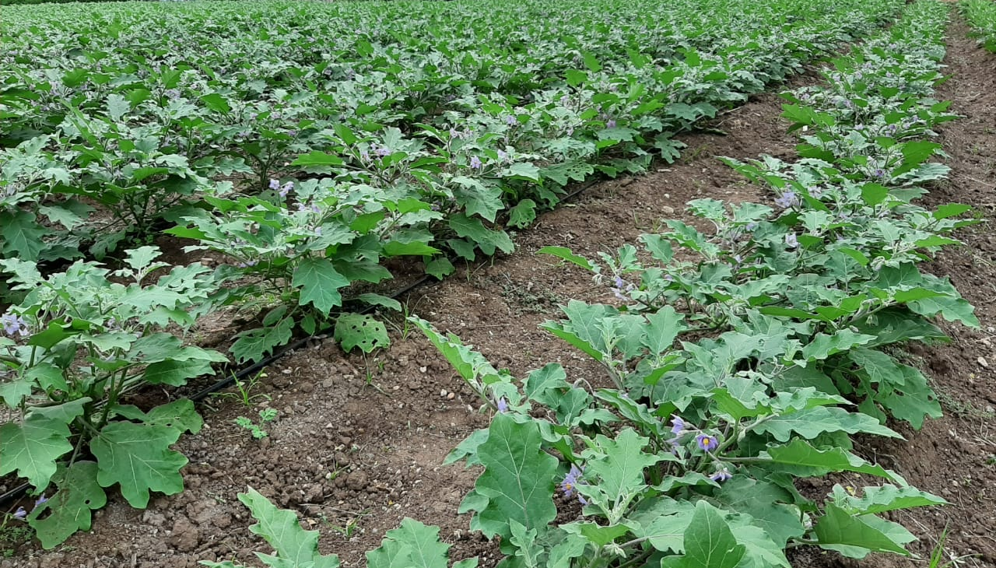
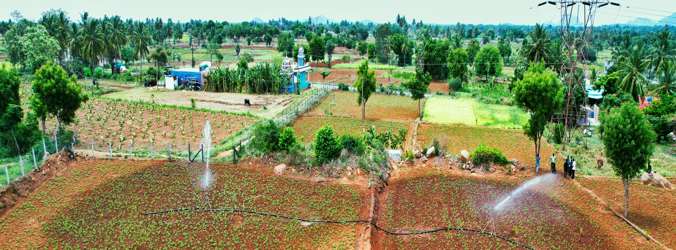

Slide 21
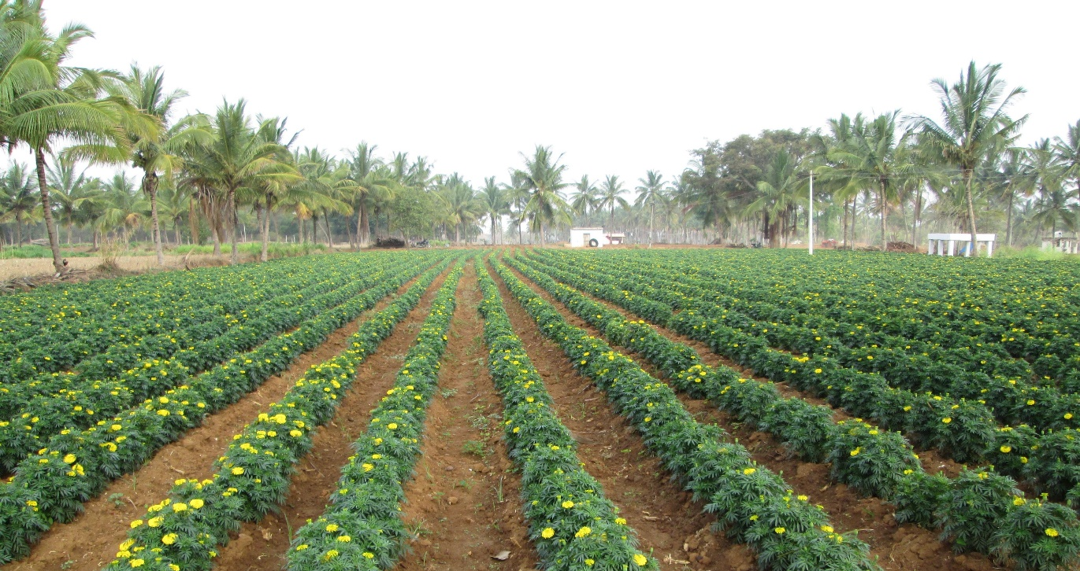
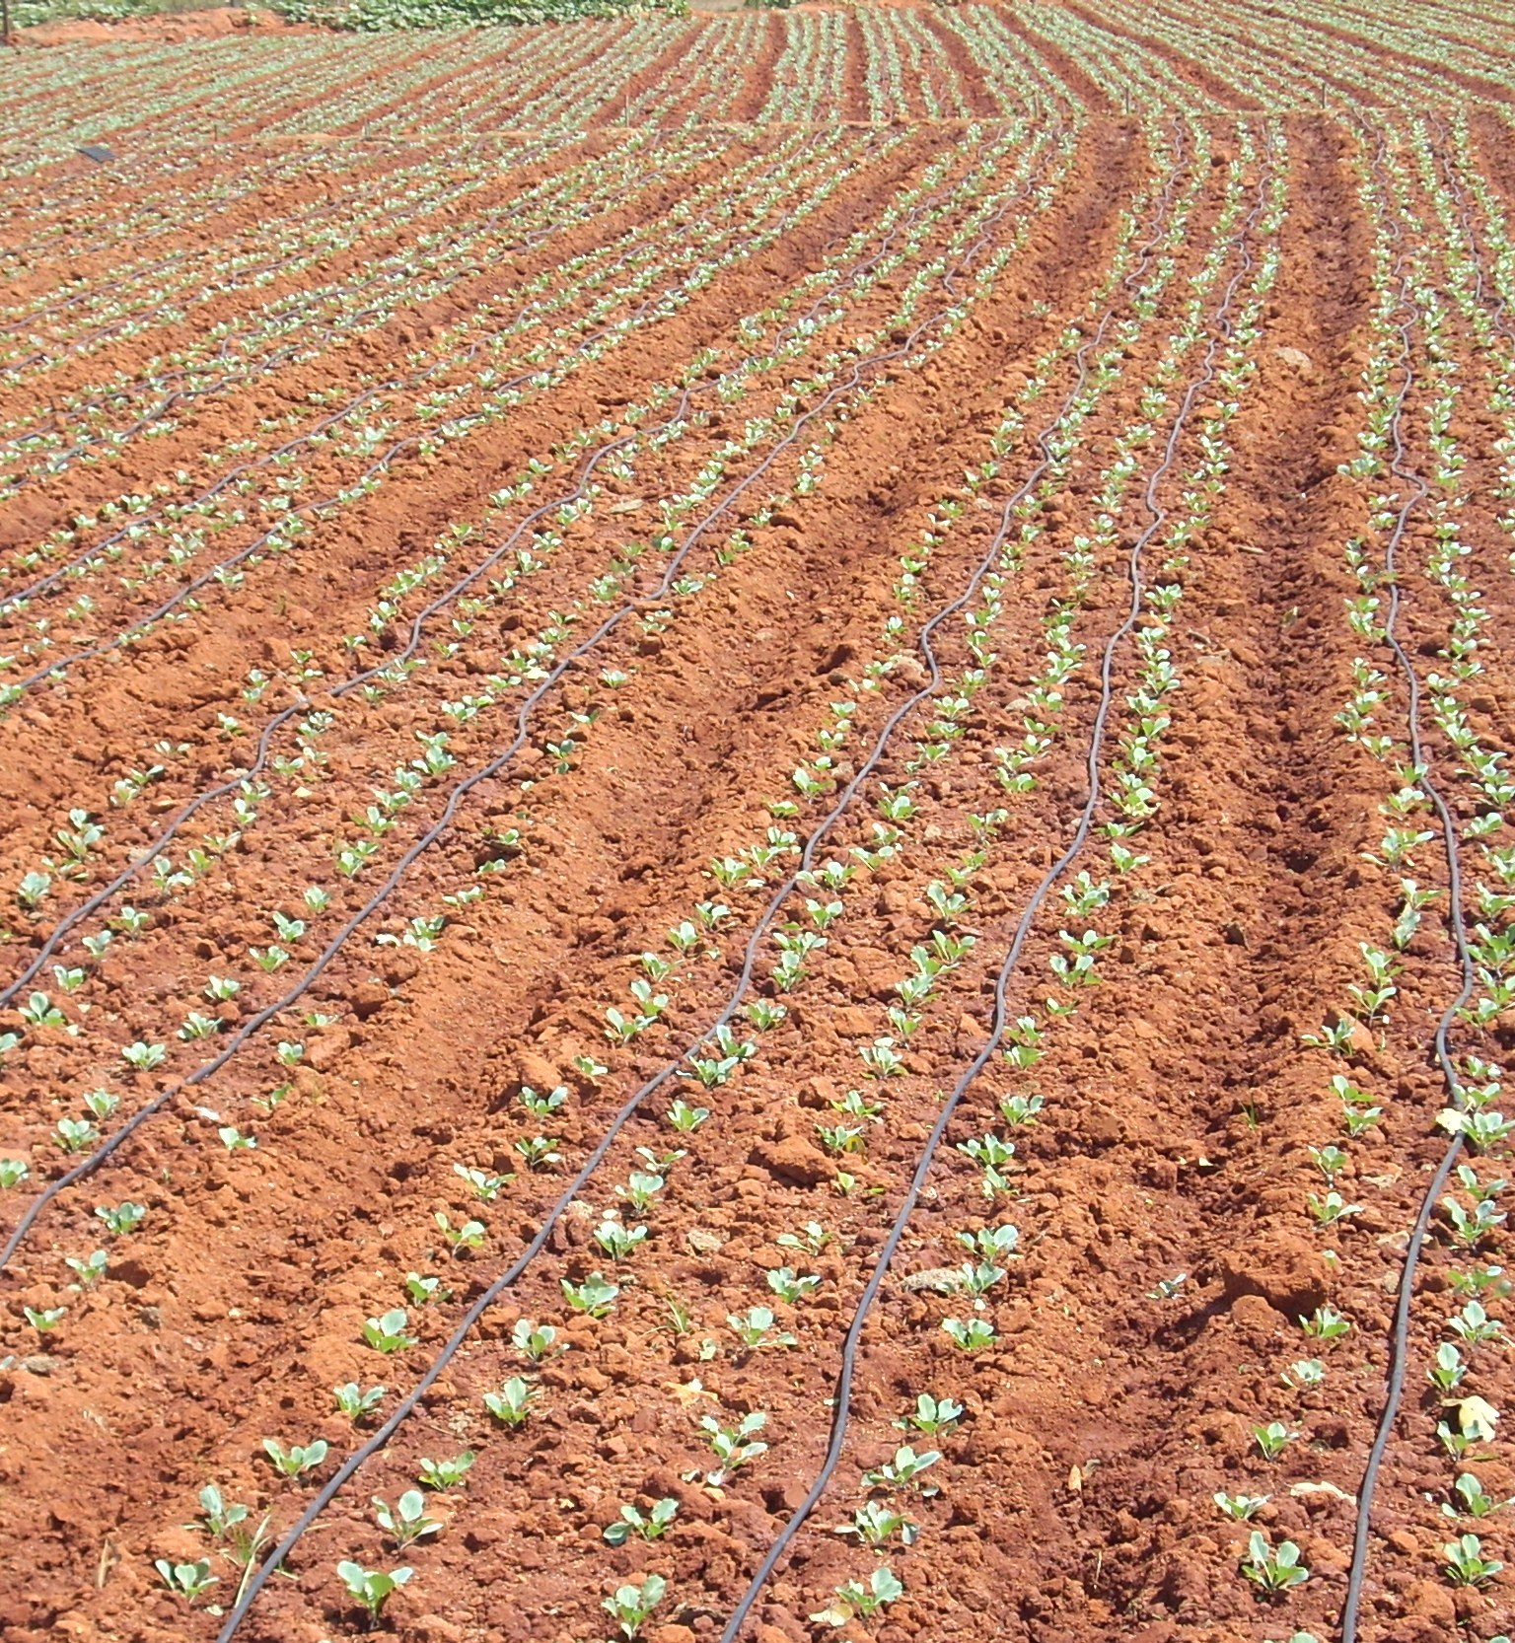
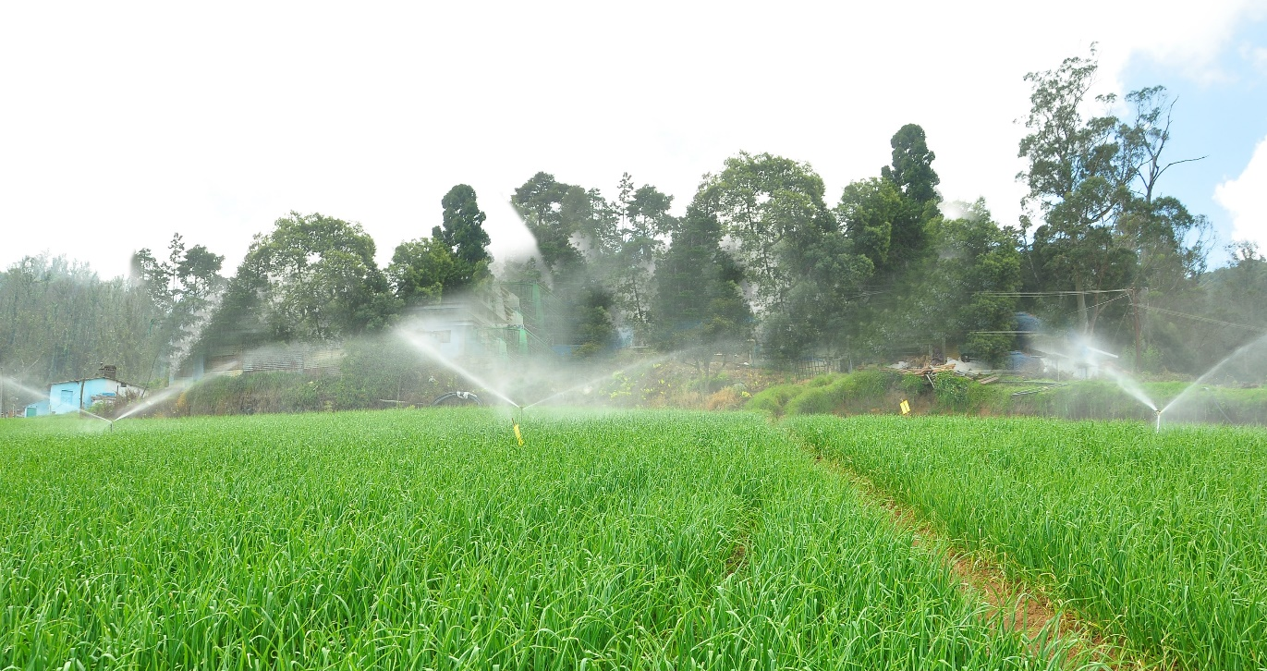
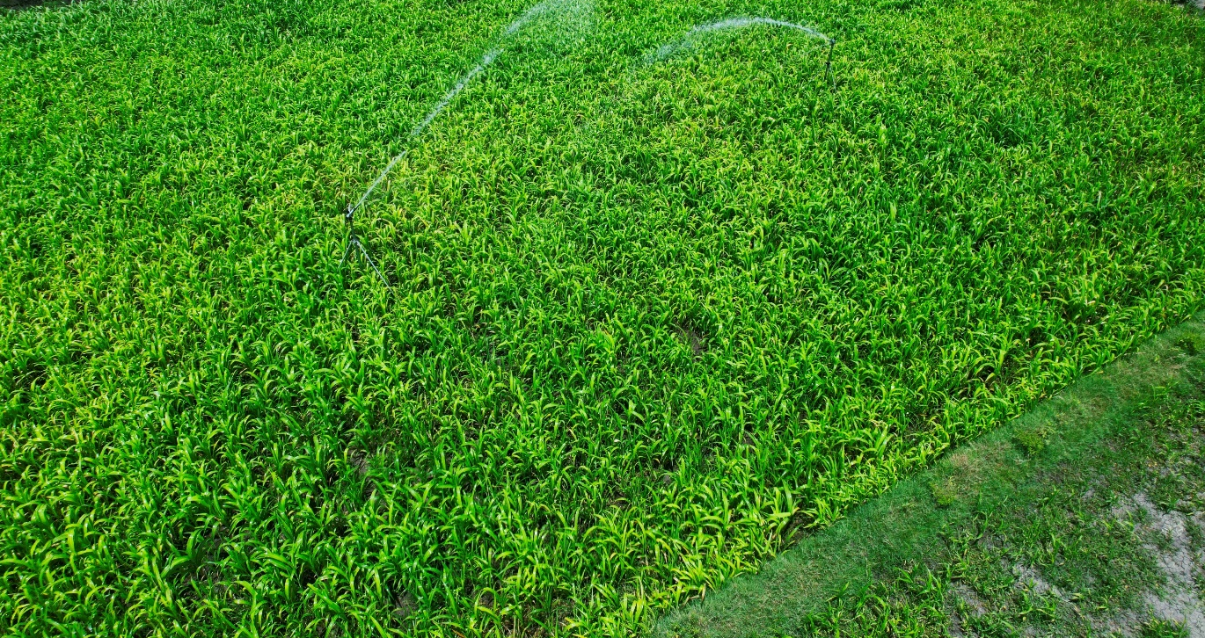
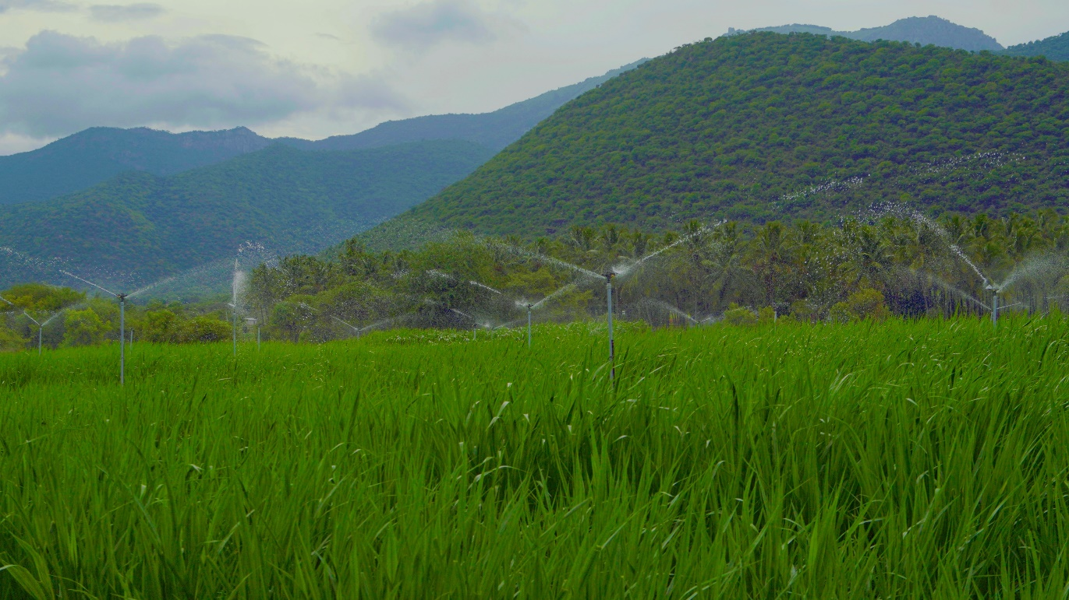
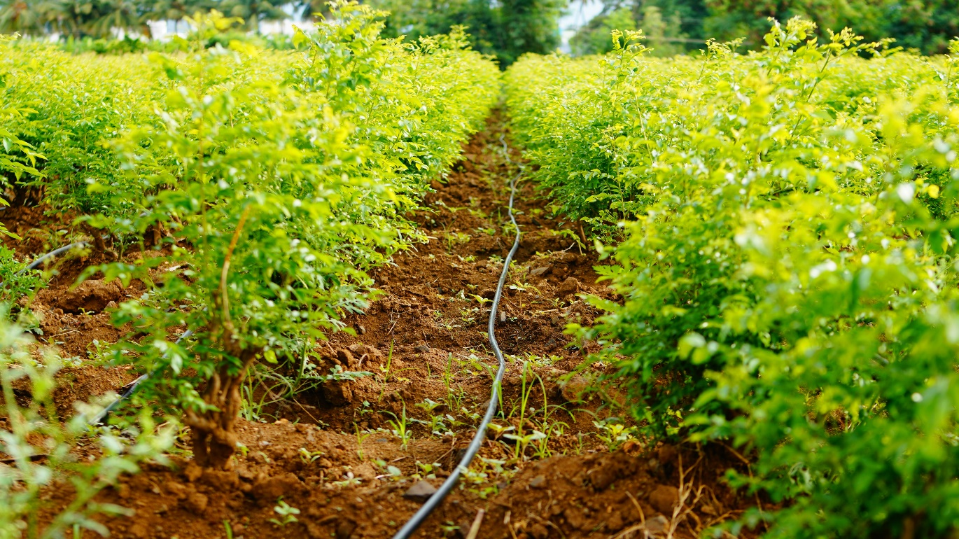
https://1drv.ms/v/s!AinrqkBb1lghgi52xewnS4BTMIXQ?e=IxKJWM
Video on TN Micro Irrigation

Slide 22
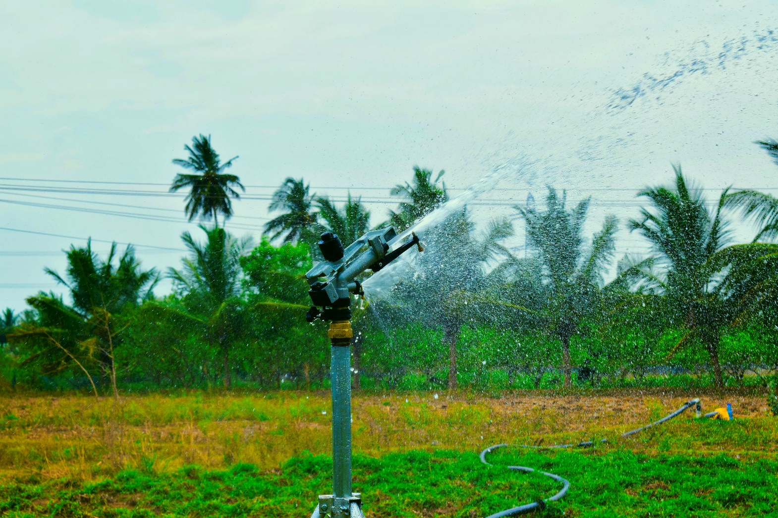
THANK YOU

