Slide 1
Micro Irrigation
Progress Monitoring System
User Manual
Under
PMKSY
(http://pmksy.gov.in)

Slide 2
A web enabled progress monitoring system which facilitates district wise physical and financial progress data entry and report generation on Draught Prone Area Program (DPAP), Desert Development Program (DDP) and other category of micro irrigation projects.

Slide 3
PMKSY Portal
Micro Irrigation Website
Progress Monitoring System
Login
State Wise Physical and Financial Target
District Wise Physical and Financial Target
District Wise Physical Progress
District Wise Financial Progress
District Wise Physical and Financial through Excel File
Add Beneficiary
Reports
Contact Details

Slide 4
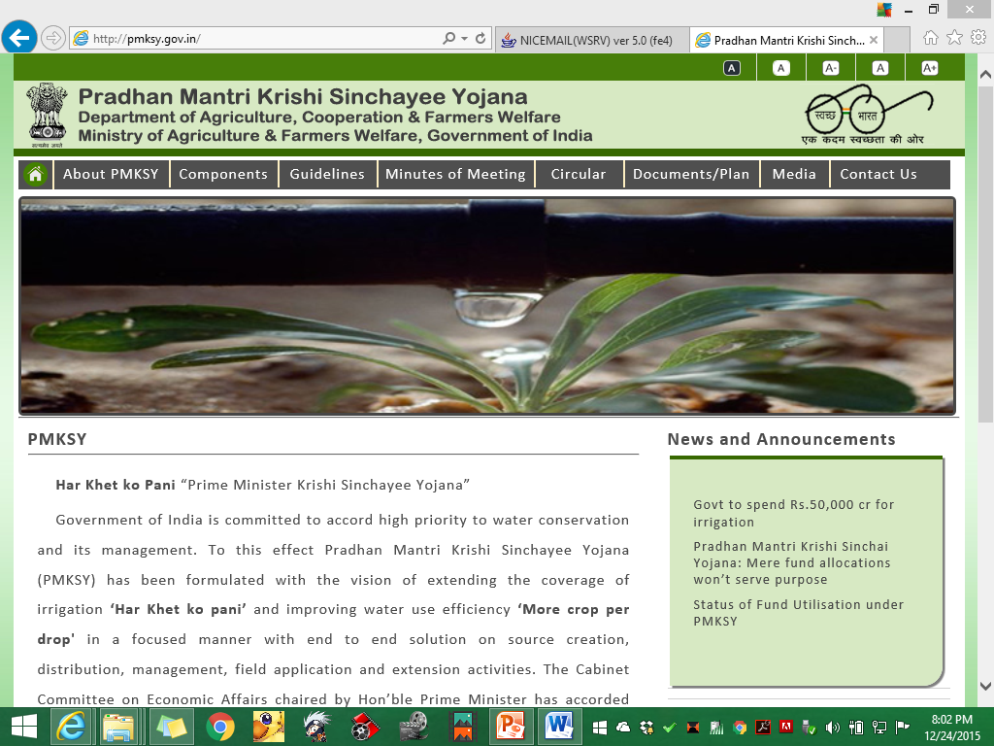

Slide 7
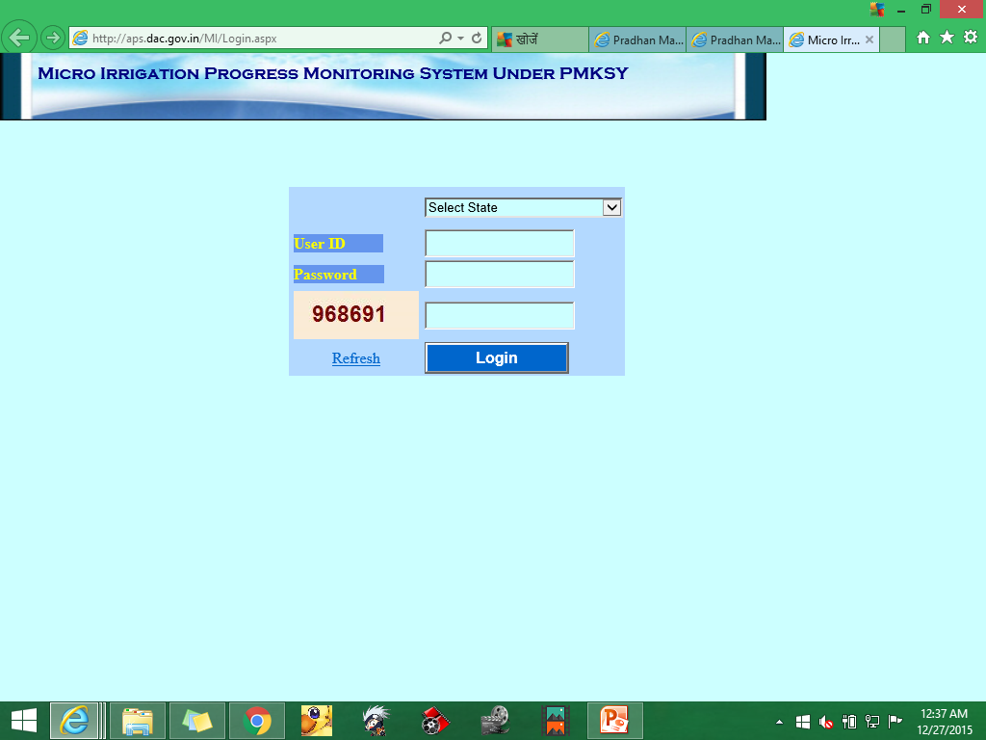
Login Form

Slide 8
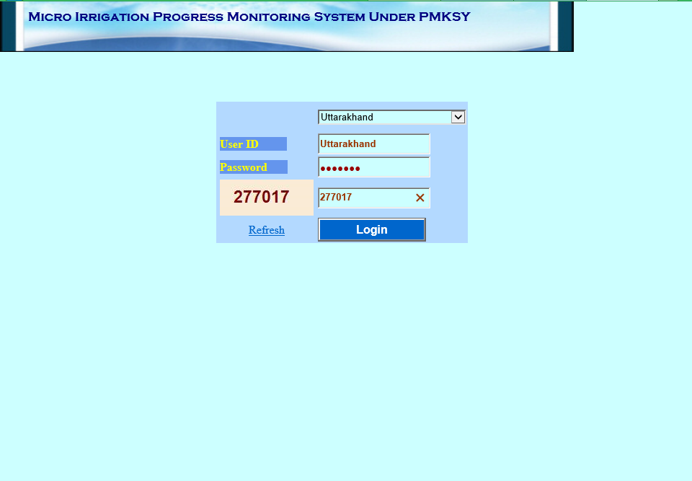
Login Form

Slide 9
Home
Home

Slide 10
1. State Wise Physical & Financial Target

Slide 12
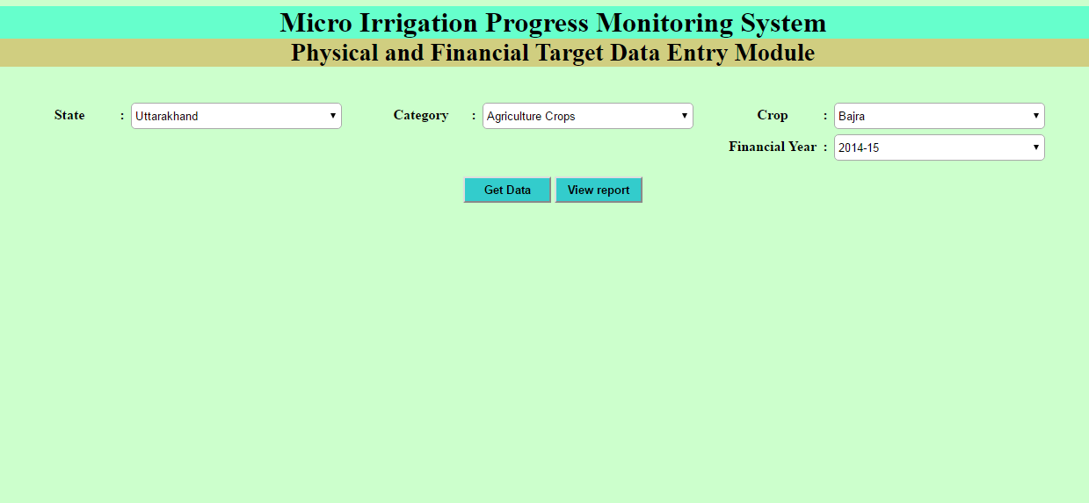
2. District Wise Physical & Financial Target

Slide 13
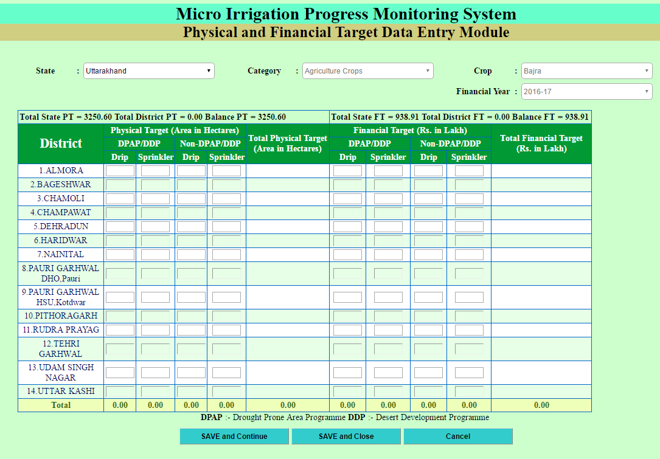

Slide 14
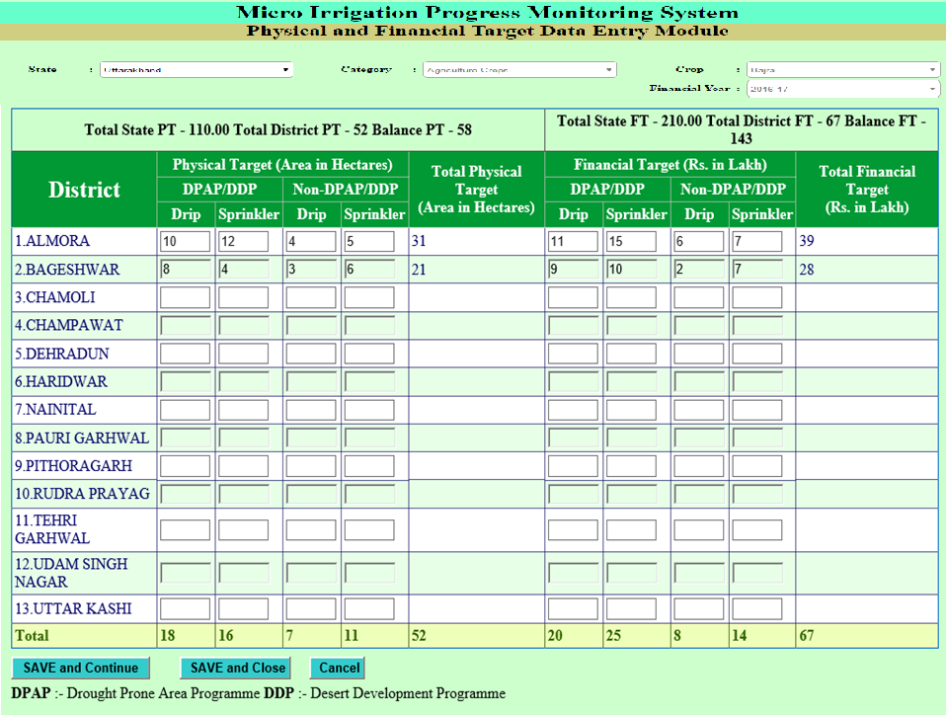

Slide 15
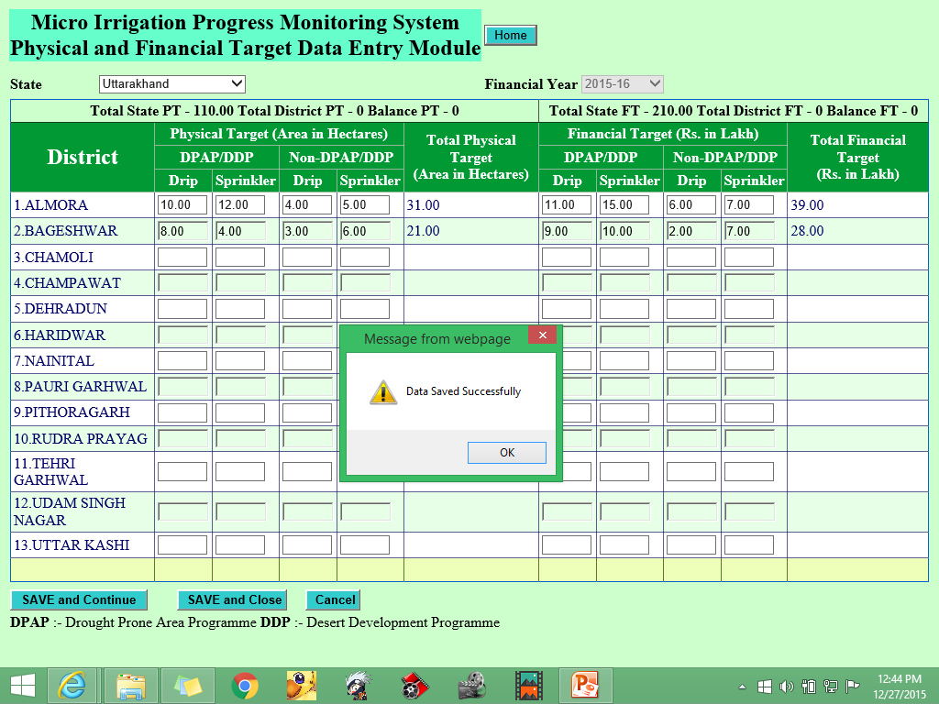

Slide 16
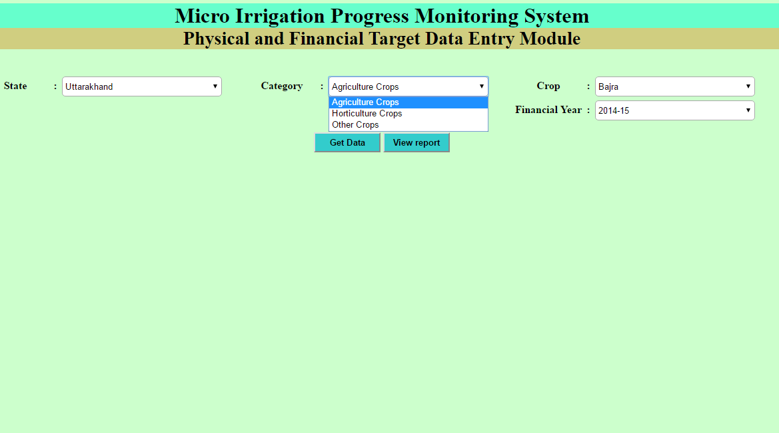
Select the Category

Slide 17
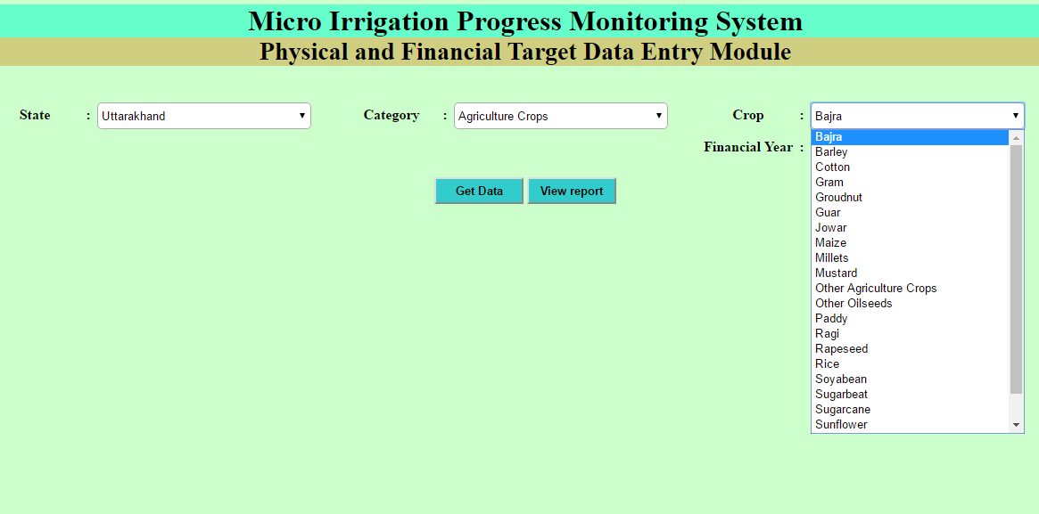
Select Crop

Slide 18
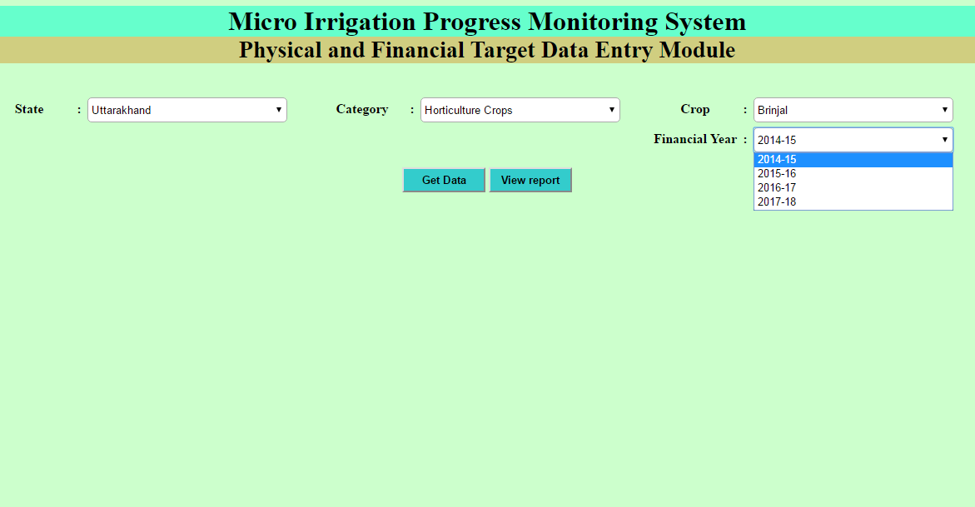
Select Financial Year
After all selection → click on Get Data Button

Slide 19
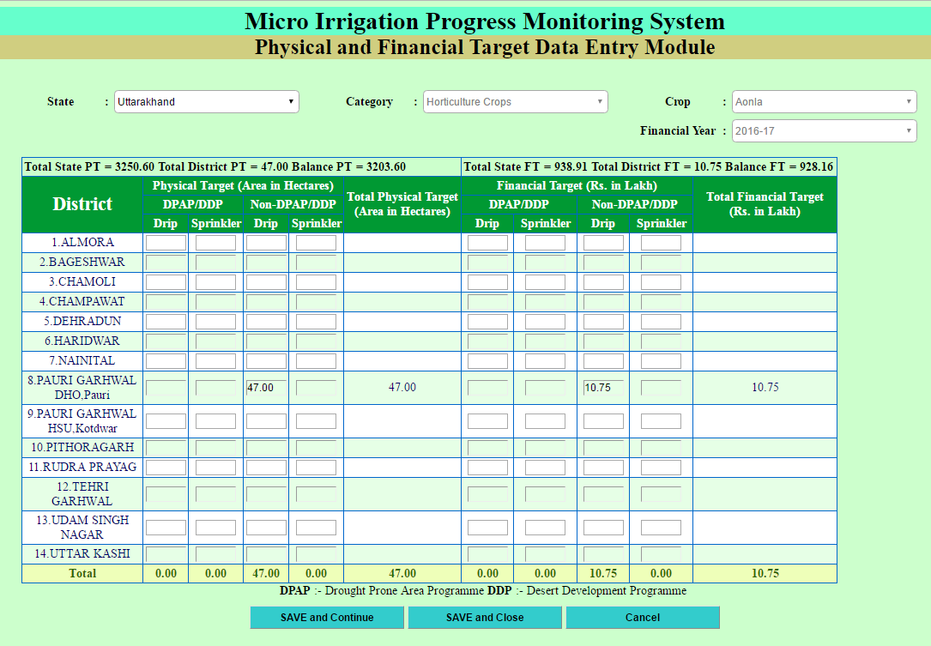

Slide 20
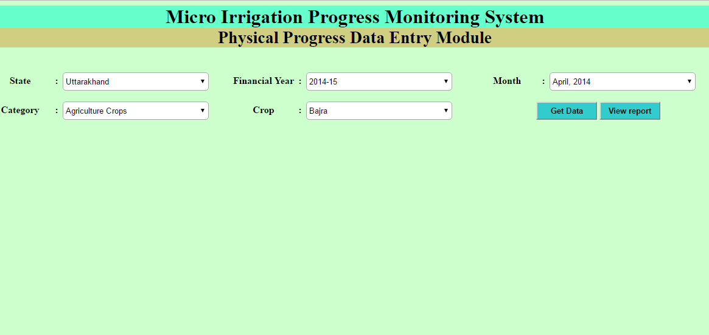
3. District Wise Physical Progress
Select the Financial Year
Select Month
Select Category
Select Crop
After Selection → Click on Get Data Button

Slide 21
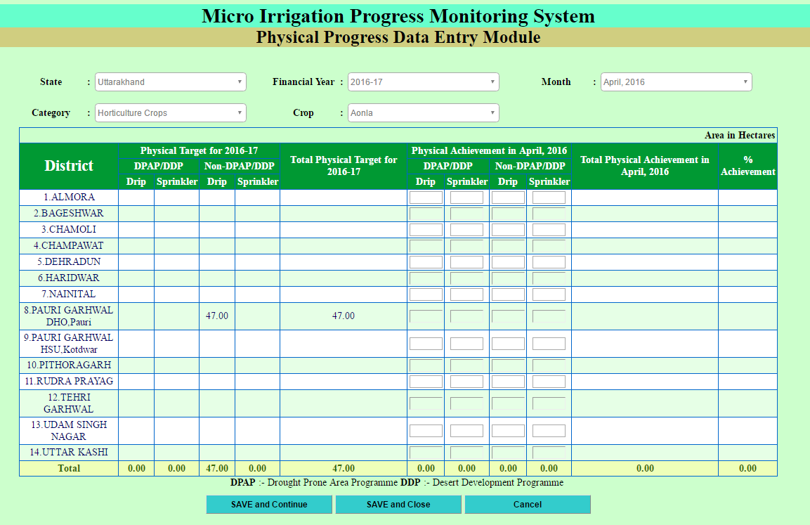

Slide 22
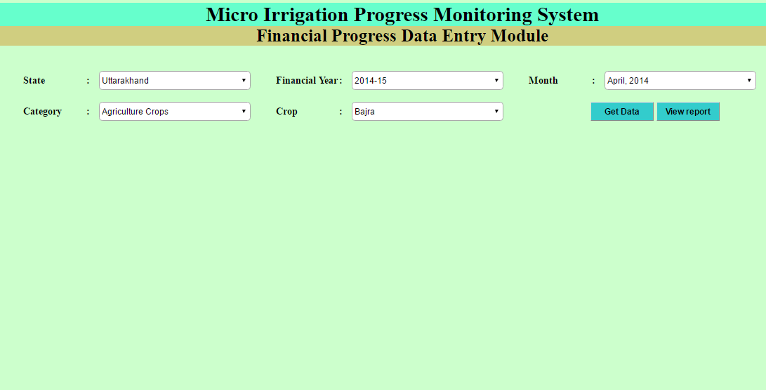
4. District Wise Financial Progress

Slide 23
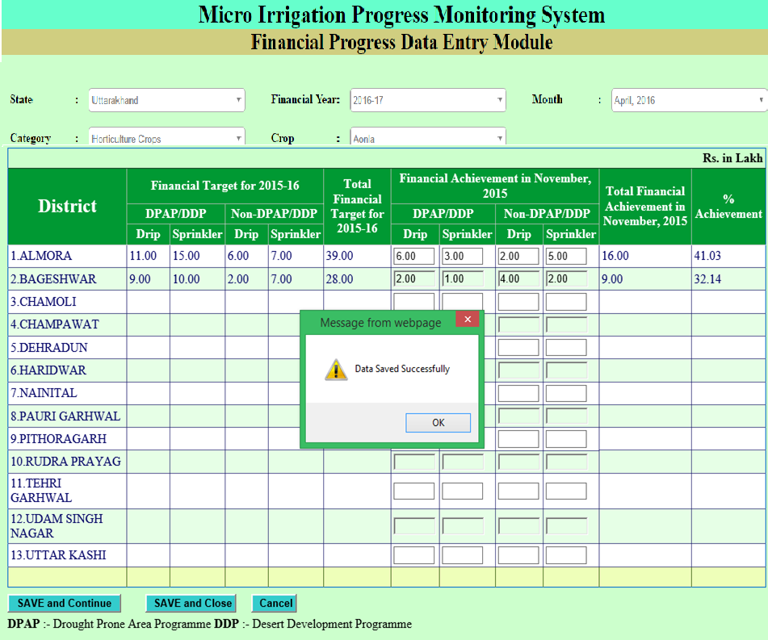

Slide 24
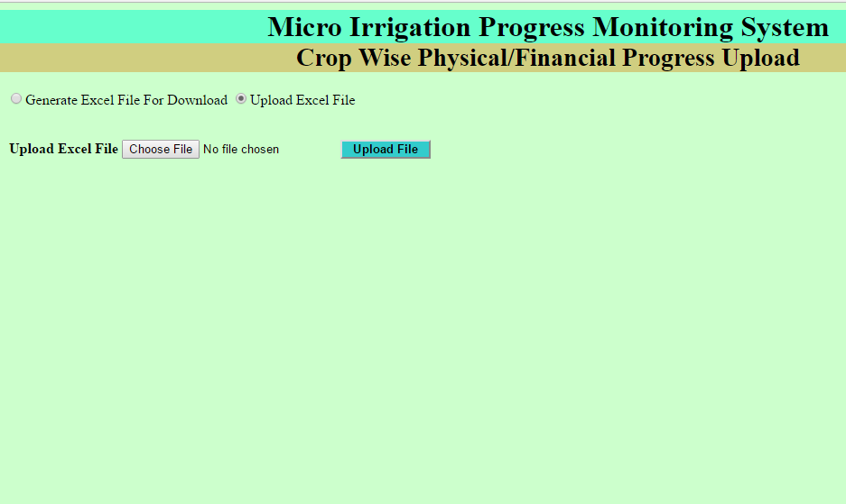
5. District Wise Physical & Financial Progress through Excel File
For Generate the excel file format
For Uploading the proper format of excel
Reports

Slide 25
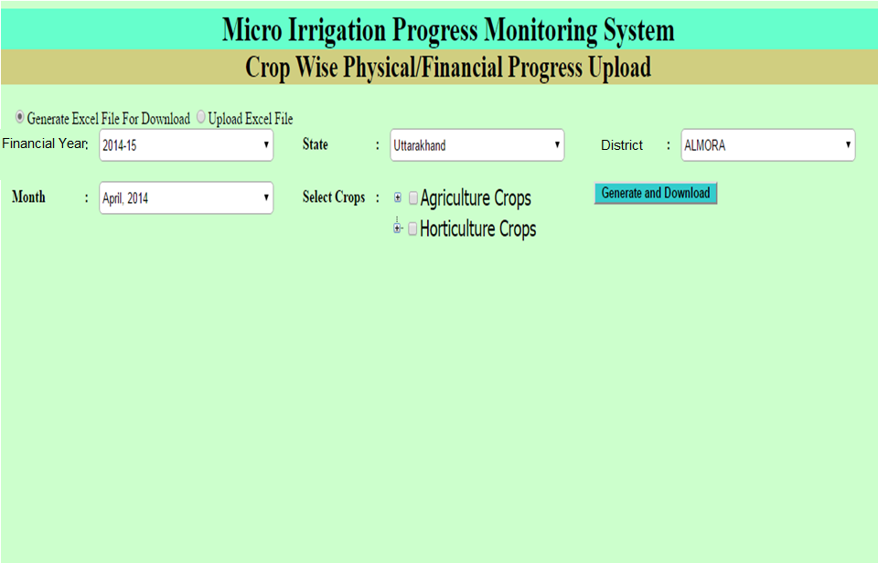
After click on “Generate Excel File For Download”
Select the credentials like
Financial Year, State, District, Month & Crops
After All selection → click on Generate and Download button

Slide 26
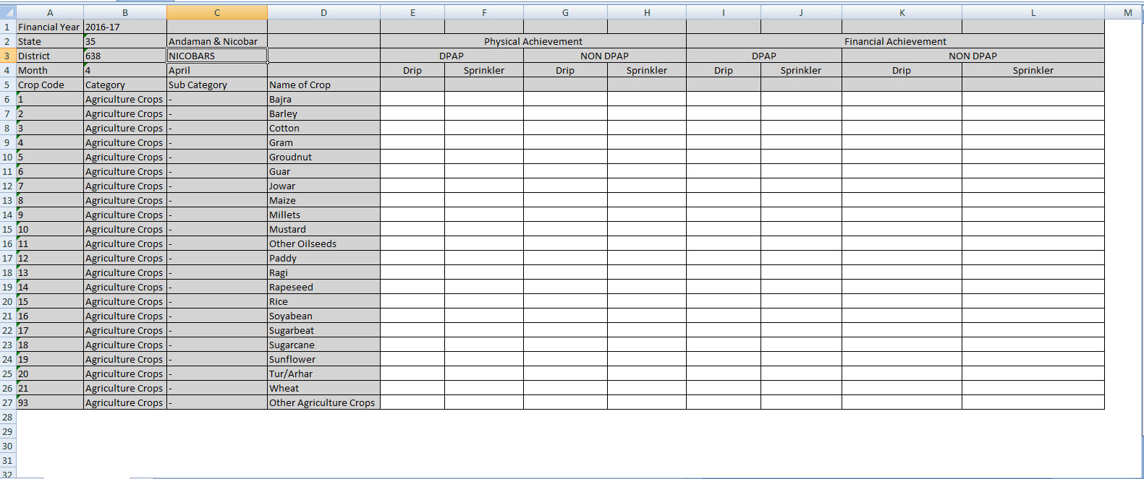
This type of format is download
After fill the proper details → Click on upload Excel File

Slide 27
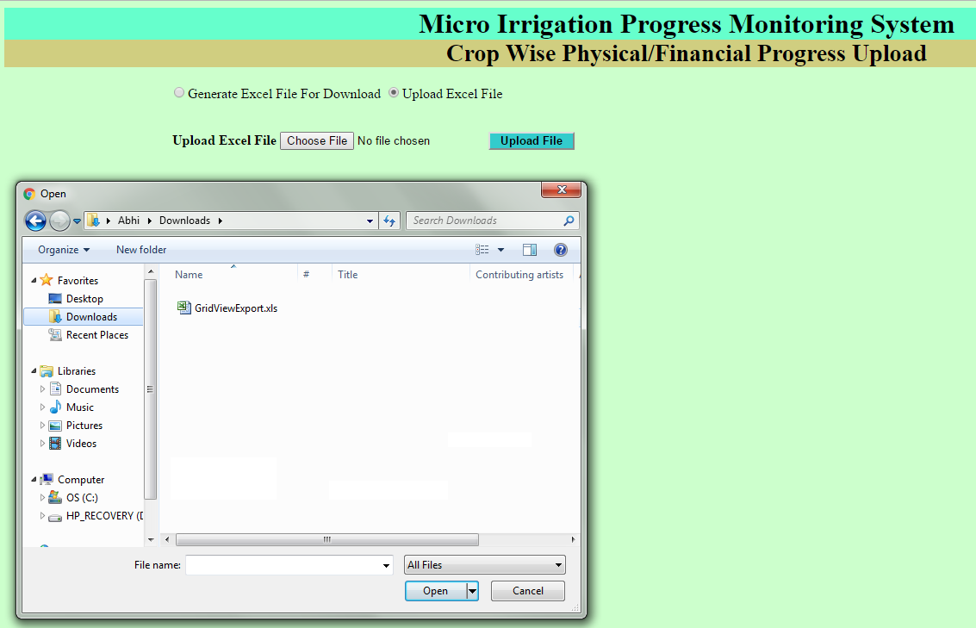
1.
4
2.
Following the points from 1 to 4 and click on Upload File button
3

Slide 28
6. Add Beneficiary

Slide 29
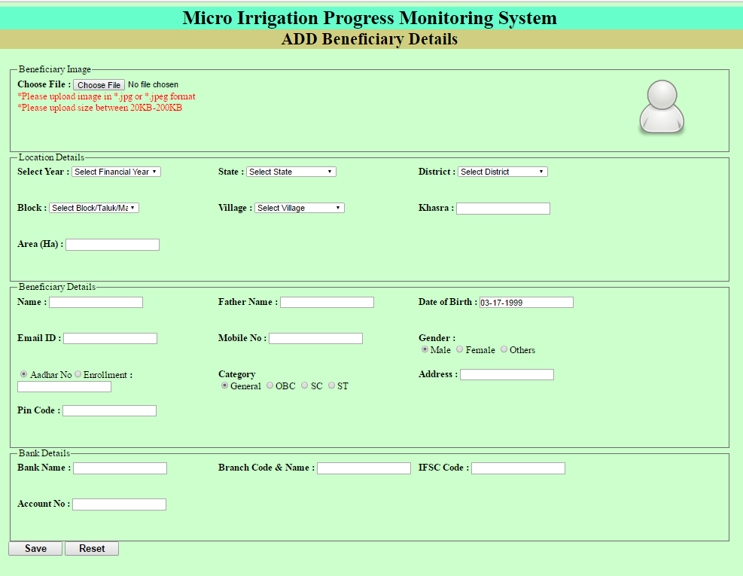
Fill all details like Location Details, Beneficiary Details, Bank Details

Slide 30
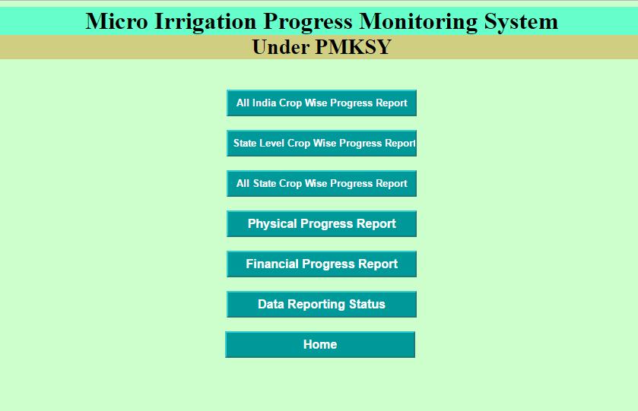
7. Reports

Slide 31
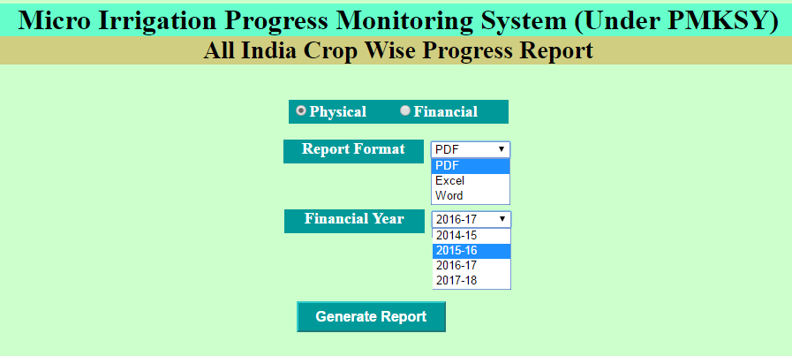
7.1 → All India Crop Wise Progress Report
1
2
3
4
Follow the points and generate the Physical Report
For Financial Select Radio button “Financial ”

Slide 32
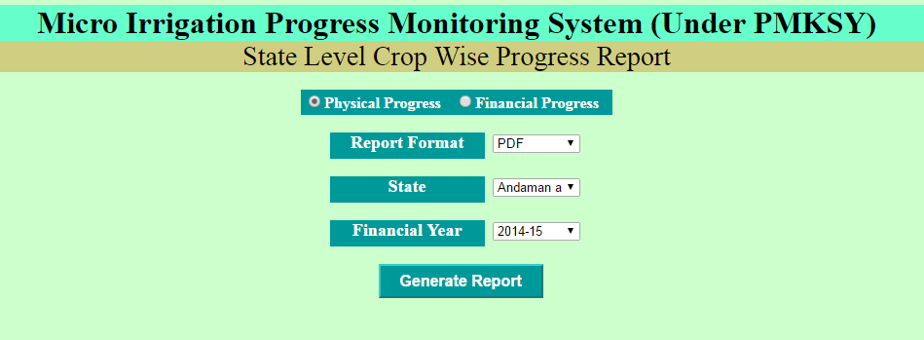
7.2 → State Level Crops Wise Progress Report
Select Physical/Financial Progress
Report Format like PDF, EXCEL, WORD
Select State
Select Financial Year
Click on Generate Report

Slide 33
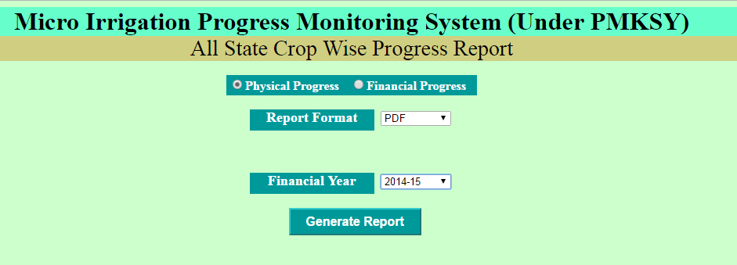
7.3 → All State Crop Wise Progress Report
Select Physical/Financial Progress
Select Format
Select Financial Year
Generate Report

Slide 34
7.4 → Physical Progress Monitoring Report
Select State
Select Financial Year
Select Month
Select Cumulative
Click on View Report

Slide 35
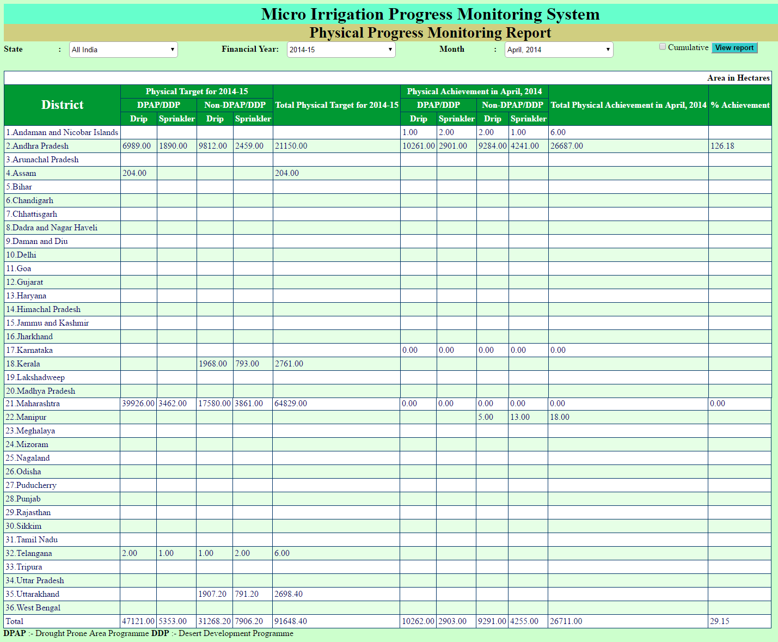

Slide 36
7.5 → Financial Progress Monitoring Report
Select State
Select Financial Year
Select Month
Select Cumulative
Click on View Report

Slide 37
7.6 → Data Reporting System
Select Financial Year
Click on View Report

Slide 38
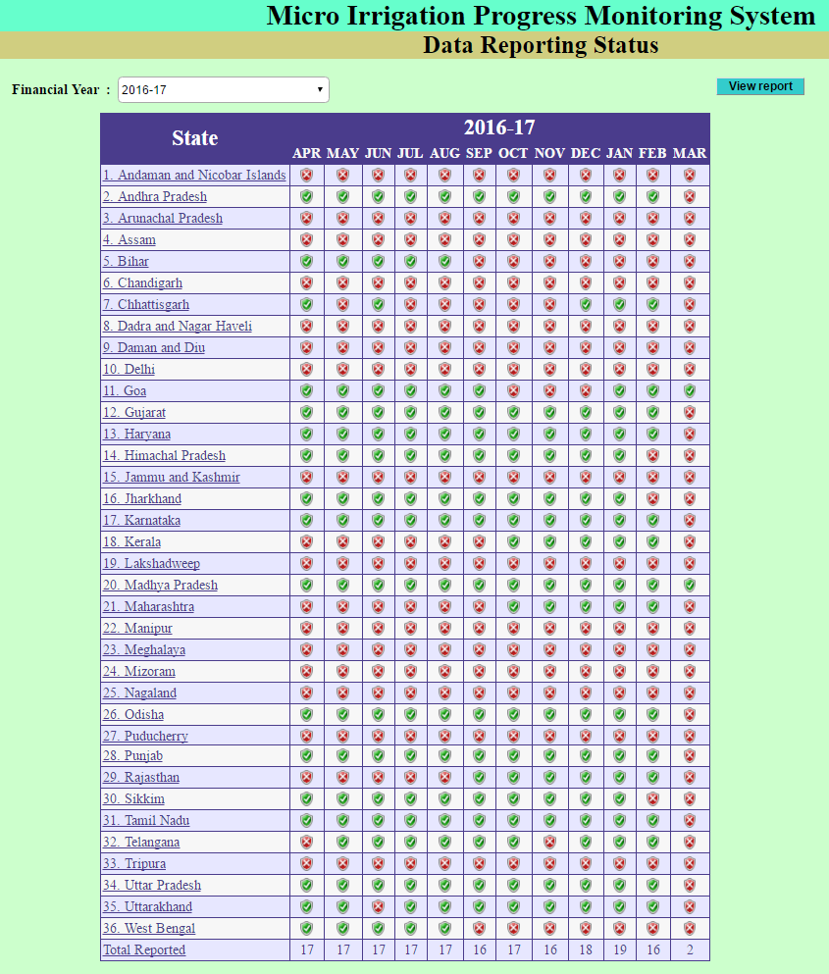

Slide 39
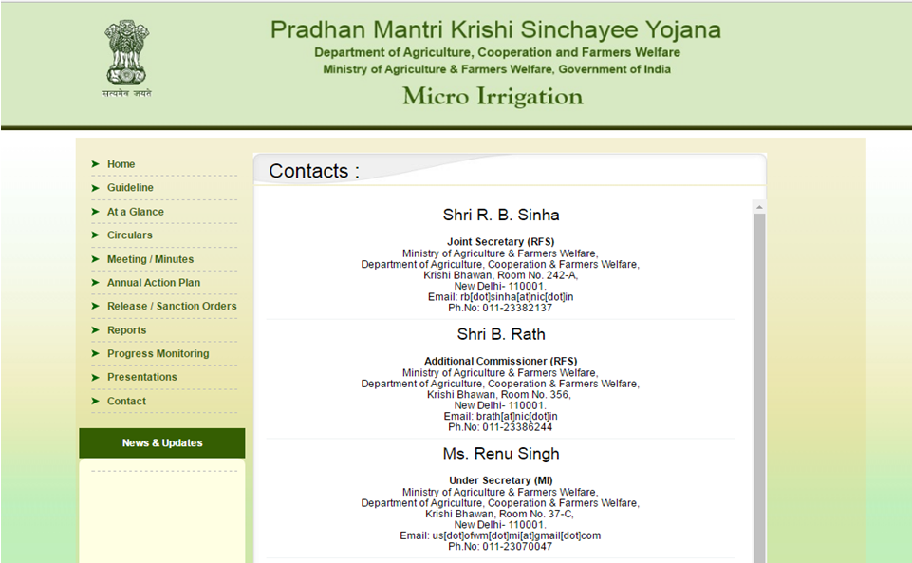
Contact details

Slide 40
Support/Feedback
support.pmksy-dac@gov.in
Thanks

