Slide 1
STATUS OF IMPLEMENTATION OF PMKSY- PER DROP MORE CROP IN ASSAM
Presented by
Triranga Bharatiya Borah
Director of Horticulture & Food Processing, Govt. of Assam

Slide 2
Basic Information
Assam is the gateway of entire North East except Sikkim
All the North East States are Hilly origin except Assam which has a mixture of Plain areas as well as hilly terrain.
Average annual rainfall of Assam is 2584.5 mm which is much higher than the National Average of 1180 mm.
Micro Irrigation in ASSAM is still in early stages compared to many of the States in India.
However there is lot of Scope for Micro Irrigation in the Agri -Horti sector in the entire North East

Slide 3
Land Use Pattern in Assam
(lakh hectare)
Geographical area | 78.43
Forest | 18.53
Barren & Uncultivable land | 14.08
Land put to non-agricultural uses | 25.14
Cultivable Waste land | 1.6
Permanent pastures & other grazing land | 1.72
Land under misc. tree crops & groves | 2.22
Total fellow | 2.00
Gross Cropped Area | 40.04
Net Cropped area | 27.23
Area Sown more than once | 12.81
Cropping Intensity | 147.03

Slide 4
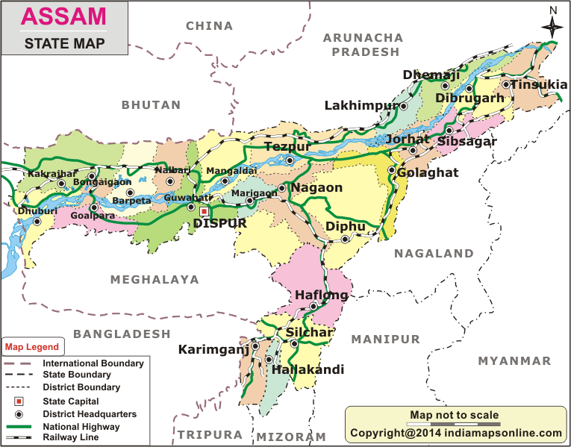
6 Agro Climatic zones, 33 Districts
Lower Brahmaputra Valley zone= 12 Dist
North Bank Plain Zone = 6 Dist
Upper Brahmaputra Valley Zone = 6 Dist
Central Brahmaputra Valley Zone= 3 Dist
Hill zone = 3 Dist
Barak Valley Zone = 3 Dist

Slide 5
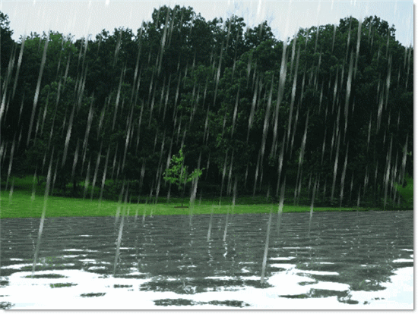
RAINFALL
Season | Normal rainfall
Winter (December, January and February) | 66.20 mm
Summer (March, April, and May) | 648.90 mm
Monsoon (June, July, August & September) | 1702.00 mm
Post Monsoon (October & November) | 167.40 mm
Annual Rainfall | 2584.50 mm

Slide 6
Irrigation Scenario of Assam
The river mighty Brahmaputra and its tributaries forms the major water source in Assam. The underground water table is high, especially in the plains of the state,. So, both wells and tanks can be dug and used as source of irrigation. Again, shallow and deep tube wells can be sunk to obtain water for irrigation.
Net Cropped Area = 27,23466 Ha
Total Area under Irrigation = 8,17040 Ha (30%)
Total Area under Micro Irrigation = 39613.4 H (only 5 % of the total Irrigated Area)

Slide 7
Micro Irrigation Scenario of Assam
In Assam National Mission of Micro irrigation iwas being implemented from 2013-14 and PMKSY(Micro Irrigation) being implemented since 2016-17.
From 2019-20 onwards, the scheme is implemented through an online state portal www.minetassam.in which is a work flow base portal.
Initially the scheme failed to attract Small & marginal Farmers as farmers contribution was 45%
Realizing the importance of the scheme GoA has allowed 30% additional Top-Up from state during 2018-19 (With an allocation of fund Rs 25 cr.) making the scheme attractive to farmers with only 15% contribution for S & M farmers and 25% for Other farmers.
However, there has been an issue regarding continuation of the Top-Up subsidy during 2022-23 and now initiative is taken from the department to place a proposal before the state Cabinet for the continuation of Top up.
The progress was slow during 2022-23 after exhaust of allocated top up fund, though there is a huge demand for Micro Irrigation in the State
Till now, we have covered an area of 38275.6 Ha only benefitting 38440 beneficiary

Slide 8
Progress Report of PMKSY-Per Drop More Crop (Micro Irrigation)
Year | Physical Achievement
 | Drip |  | Sprinkler |  | Total MI
 | Area (Ha) | Nos. of Farmers | Area (Ha) | Nos. of Farmers | Area (Ha) | Nos. of Farmers
2016-17 | 45 | 45 | 163 | 163 | 208 | 208
2017-18 | 63 | 90 | 719.2 | 654 | 782.2 | 744
2018-19 | 196.8 | 125 | 301.6 | 254 | 498.4 | 379
2019-20 | 2001.2 | 1479 | 8871.6 | 9470 | 10872.8 | 10949
2020-21 | 1833.80 | 1760 | 4897 | 4922 | 6730.8 | 6682
2021-22 | 3394.80 | 3842 | 9454 | 10012 | 12848.8 | 13854
2022-23 | 2316.8 | 1971 | 5355.8 | 4837 | 7672.6 | 6808
Total | 9851.4 | 9312 | 29762.2 | 30312 | 39613.6 | 39624

Slide 9
Comparison of Yield in Micro Irrigation cum fertigation Vs Rainfed conditions for different crops
Crop | Micro Irrigation cum Fertigation (Yield MT/Ha) | Rainfed condition (Yield MT/Ha) | Increase in Yield %
Banana | 33.18 | 24.5 | 35.45
Assam Lemon | 14.5 | 9.89 | 46.61
Potato | 17 | 11 | 54.54
Papaya | 32.32 | 27.15 | 19.04
Guava | 28.59 | 23.61 | 21.10
Litchi | 18 | 14.70 | 22.44
Cauliflower | 20.40 | 16.94 | 20.42
Brinjal | 16.10 | 14 | 15
Cabbage | 27.22 | 22.5 | 21

Slide 10
SUMMARY OF TOTAL ANNUAL ACTION PLAN, 2023-24 PROPOSED FOR Per Drop More Crop(PDMC) under PMKSY AS PER 125% OF ACTUAL ALLOCATION
Sl No. | Components | Nos of Farmers | Area in Ha/ Nos. of Units | Financial under PMKSY (Rs in lakhs) |  | Additional State Top-Up from CMSGUY (Rs in Lakh) | Total Assistance (Rs in Lakhs) | Farmers Share (Rs in Lakhs)
 |  |  |  | GOI share | State share
1 | PDMC(Micro Irrigation) | 22918 | 19466.6 Ha | 5212.00 | 579.11 | 3008.38 | 8799.48 | 1504.18
2 | PDMC (Other Intervention) | 9192 | 9192 Nos. | 1303.00 | 144.77 | 0.00 | 1447.77 | 1378.80
 | Total |  |  | 6515.00 | 723.88 | 3008.38 | 10247.25 | 2882.98

Slide 11
Prospect of Micro Irrigation in Assam
PMKSY-PDMC is able to attract many educated unemployed youth to take up cultivation of some of the high value crops like Dragon Fruits, Strawberry , Apple Ber, Vegetables under protected structure
Banana and Assam Lemon are other crops in which Drip Irrigation has become popular. Recently Assam lemon has able to find export market
There is also huge demand for Micro Irrigation in the Tea sector, the small and marginal tea growers are immensely benefitting from this scheme.
Demand is usually very high during Rabi season for all kind of vegetables , Mustard, Maize , Paddy etc.
Proposal for additional Top-Up subsidy @30% for next three years from 2023-24 to 2025-26 for an amount of 13852.81 Lakh against a target of 1(one) lakh ha has already submitted to Govt. for cabinet approval.
Hope. In the coming three years the State will be able to show some good progress .

Slide 12
Photographs of Activities

Slide 13
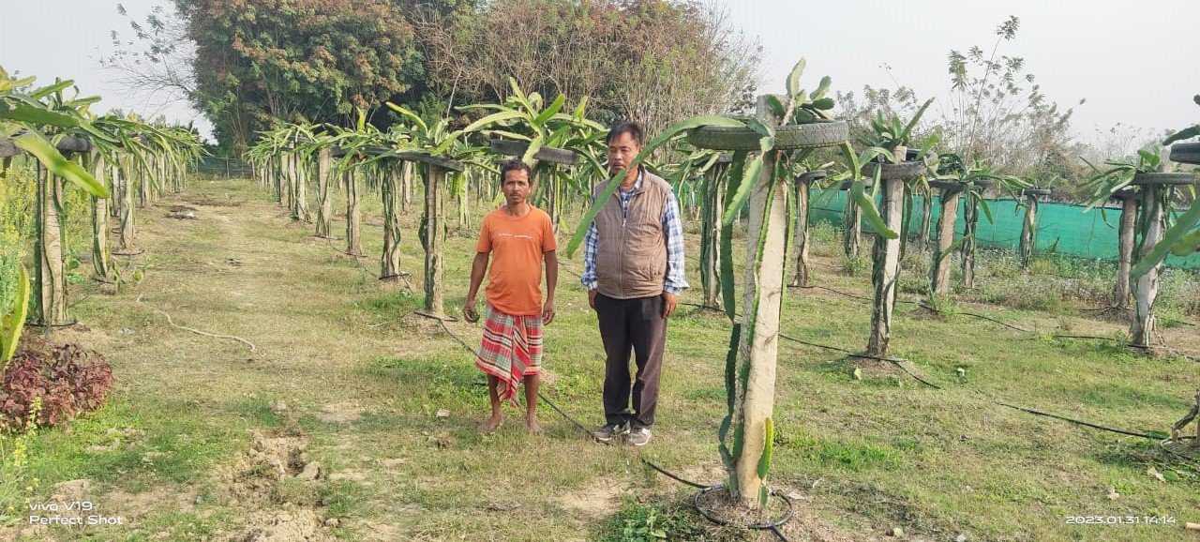
Drip in Dragon Fruit, Udalguri District

Slide 14
Capsicum with drip Irrigation in Green House, Kamrup Dist.

Slide 15
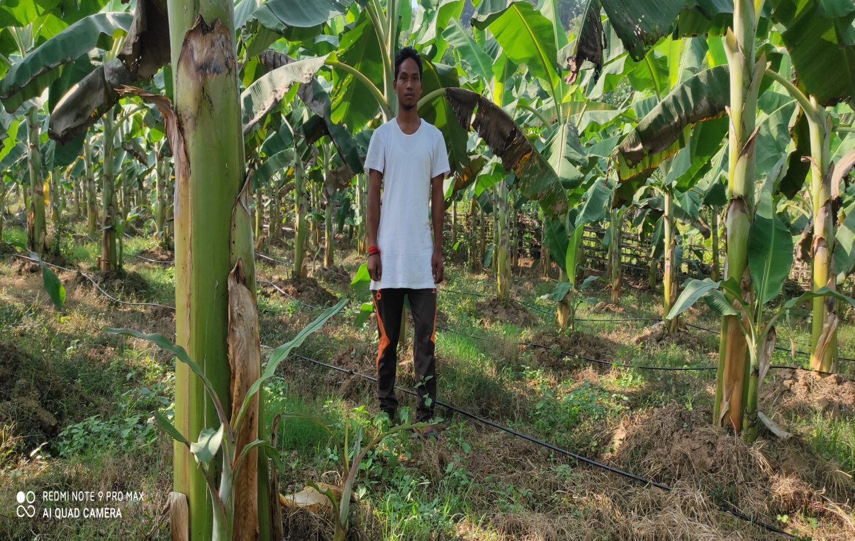
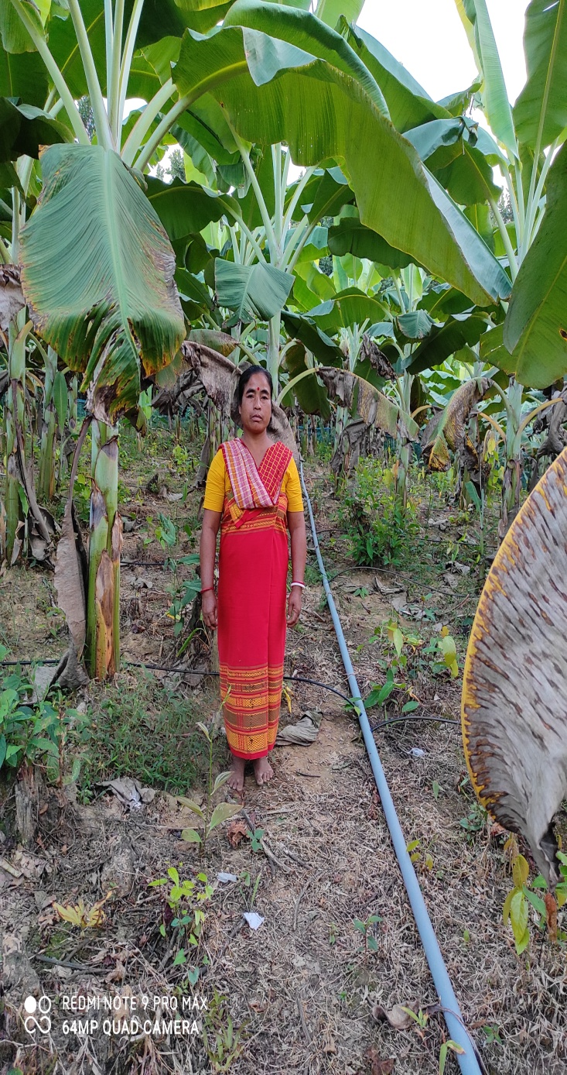
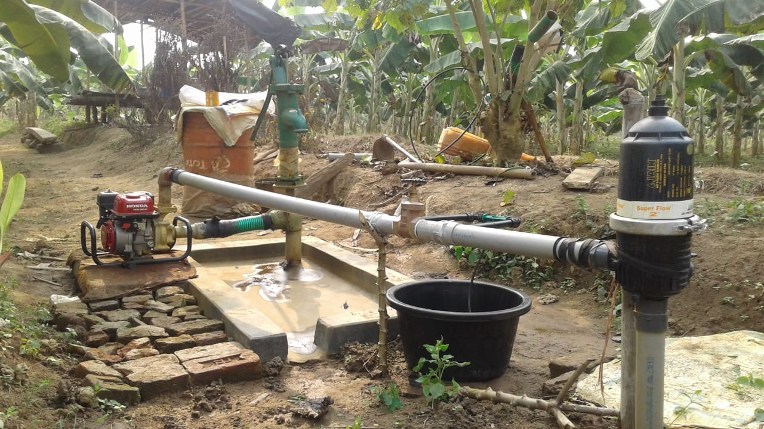
Drip in Banana, Goalpara

Slide 16
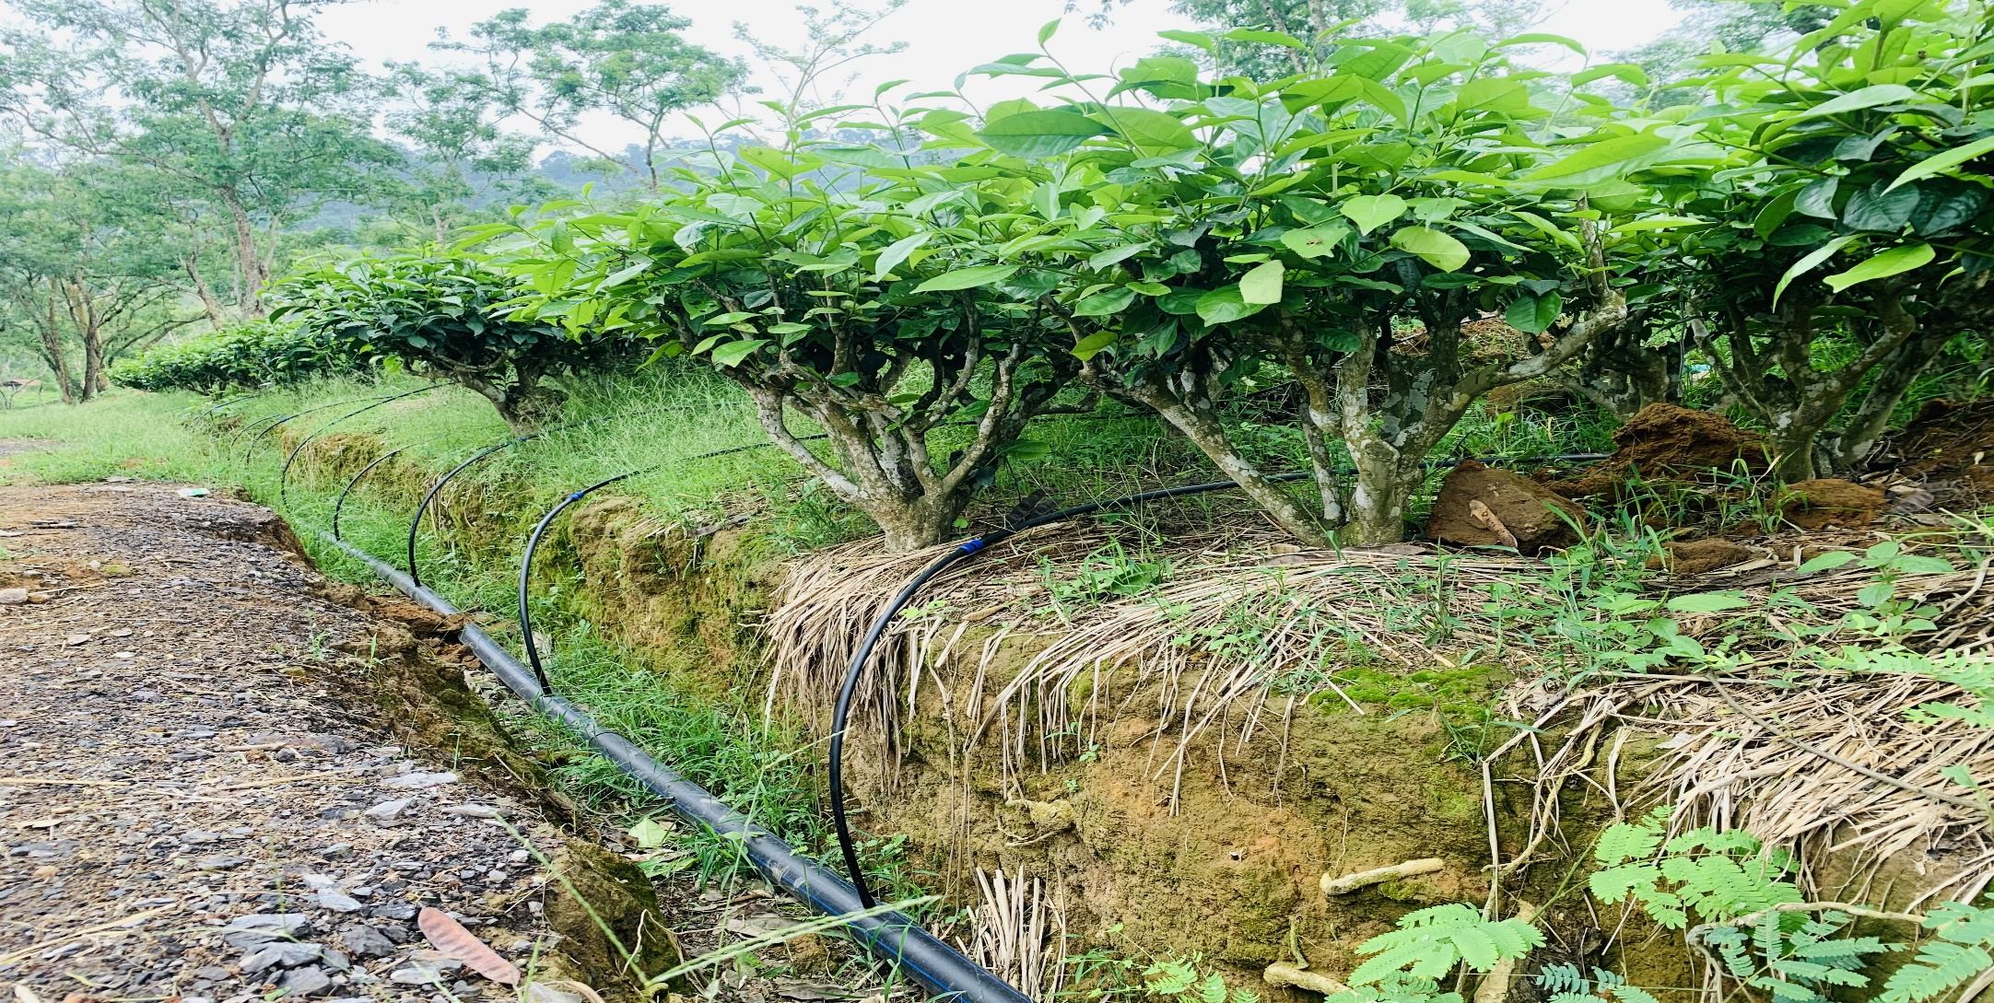
Drip in Assam Lemon
Drip in Tea

Slide 17
Drip in Papaya, Chirang District

Slide 18
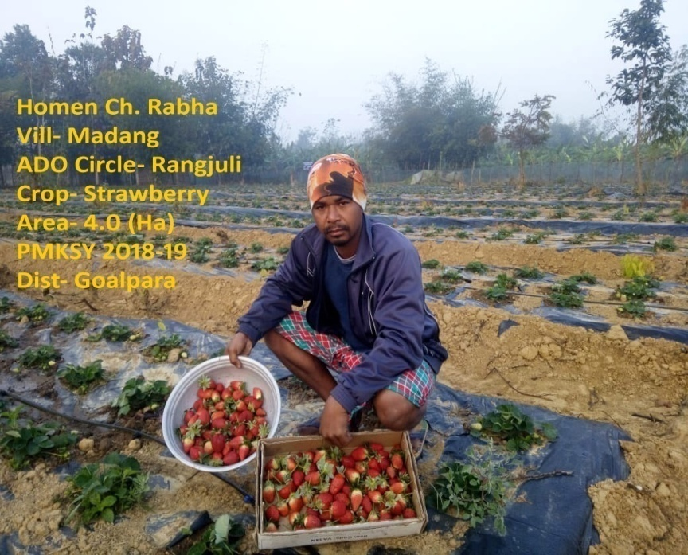
Drip in Strawberry

Slide 19
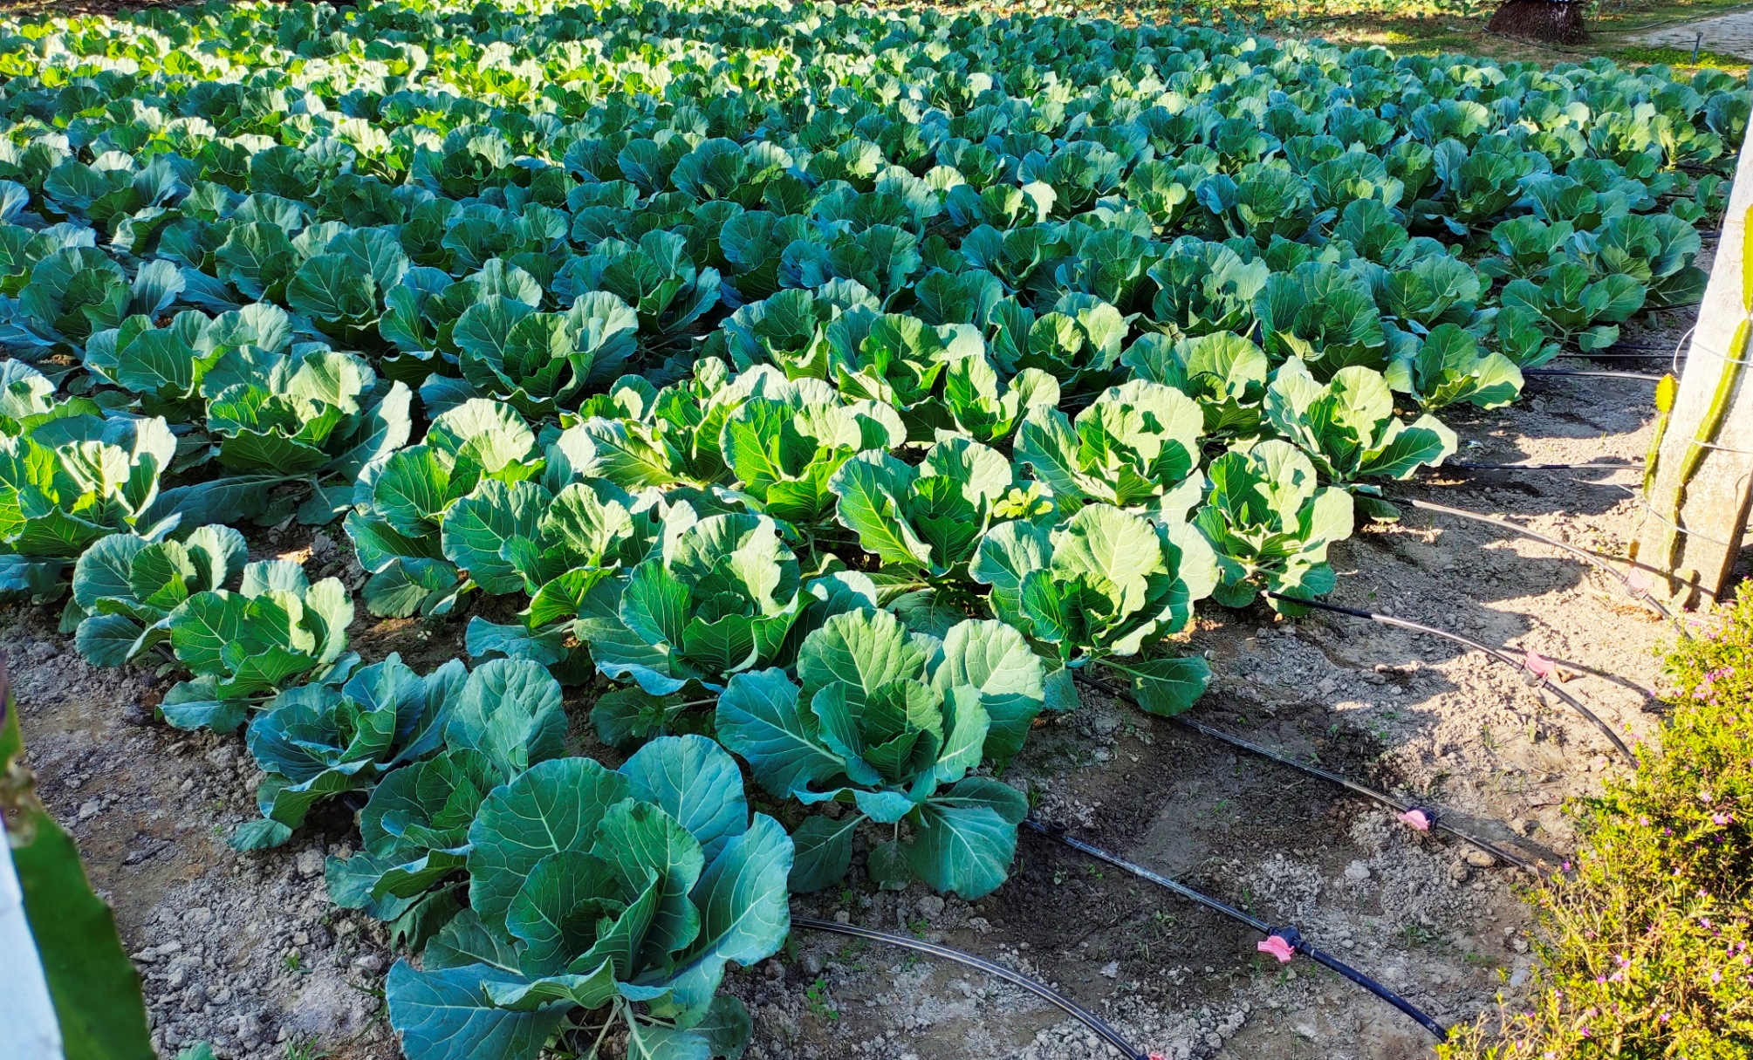
DRIP IN CABBAGE, GOLAGHAT DISTRICT

Slide 20
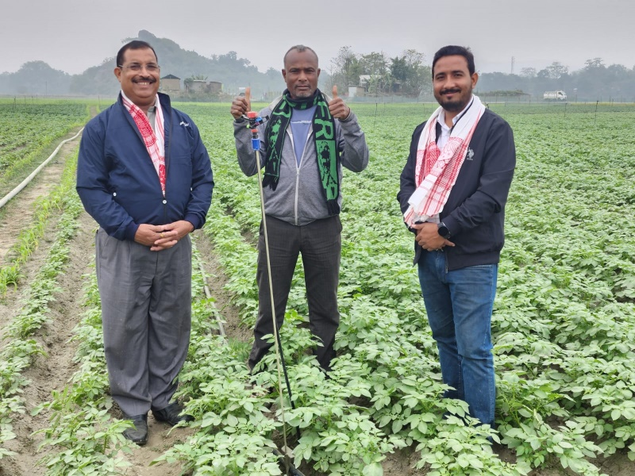
Mini Sprinkler in Potato, Sonitpur Dist

Slide 21
Mini Sprinkler in Maize, Morigaon District

Slide 22
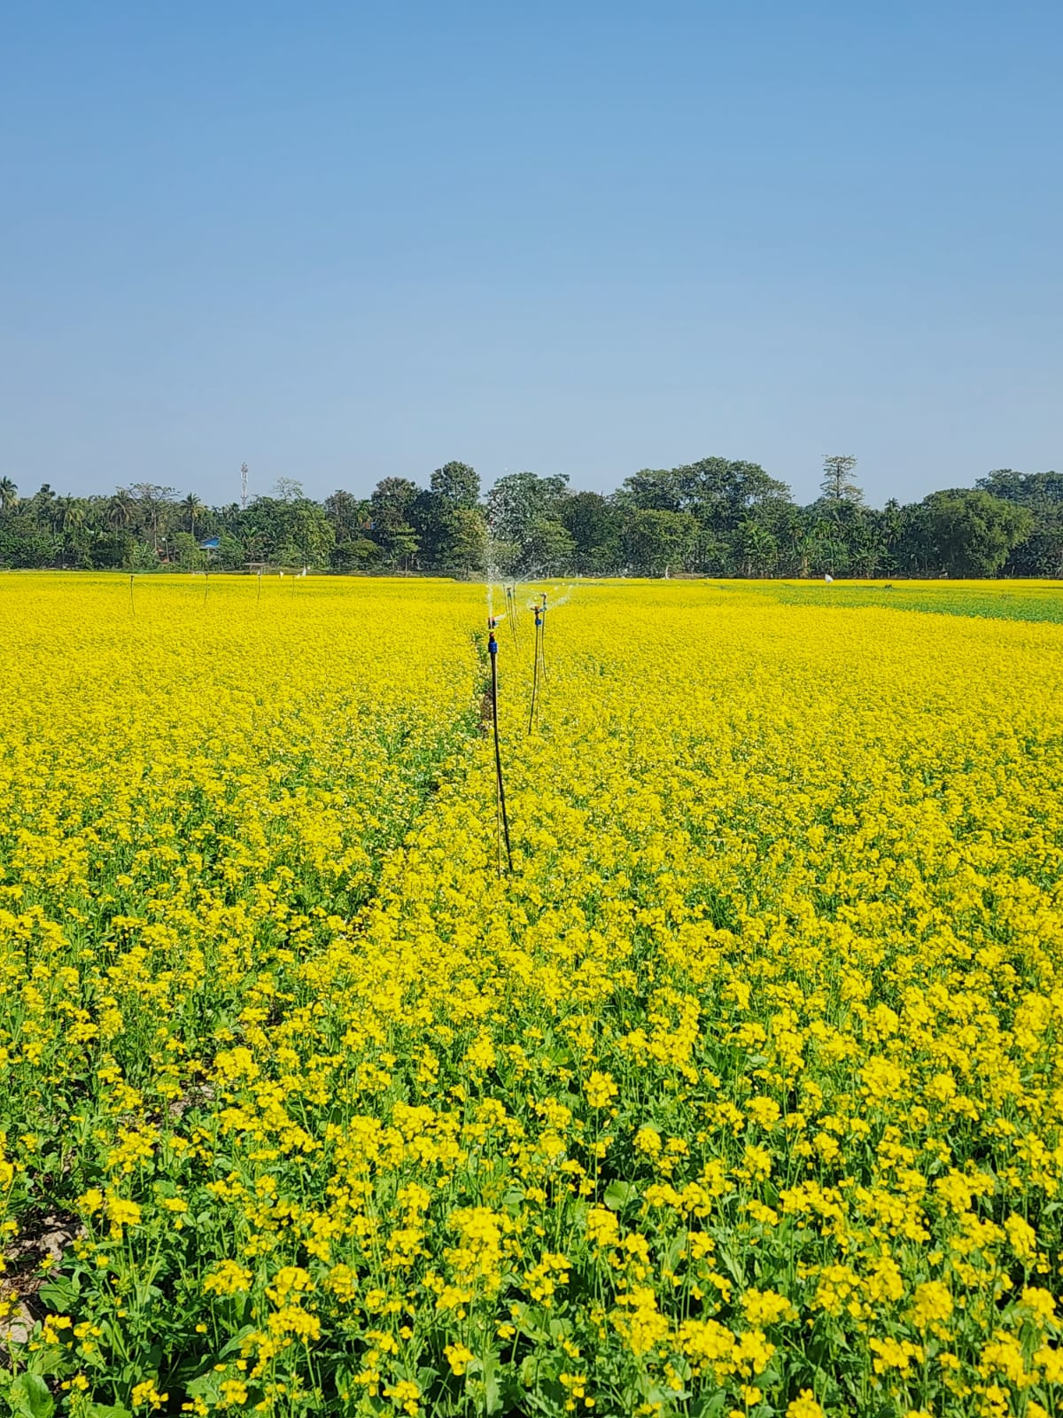
Mini Sprinkler in Mustard

Slide 23
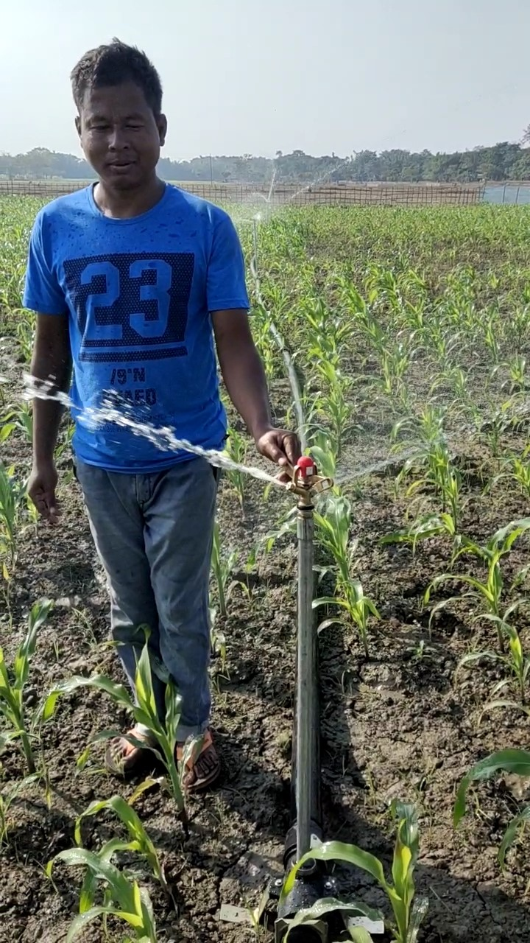
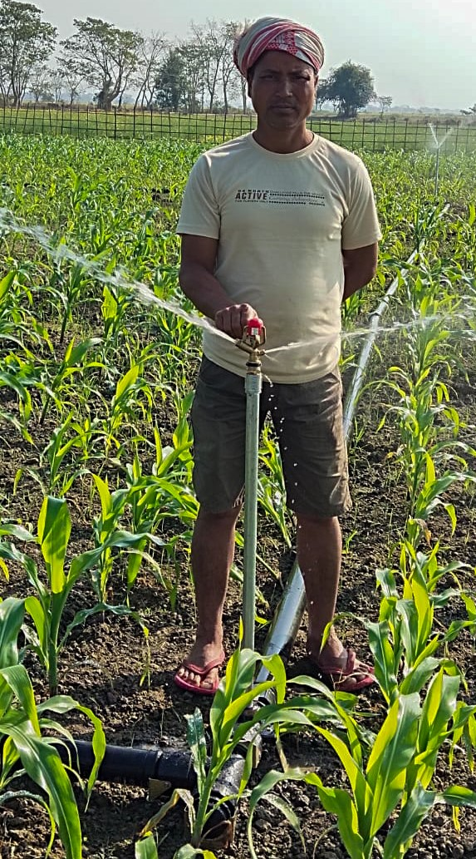
Sprinkler in Maize , Darrang District

Slide 24
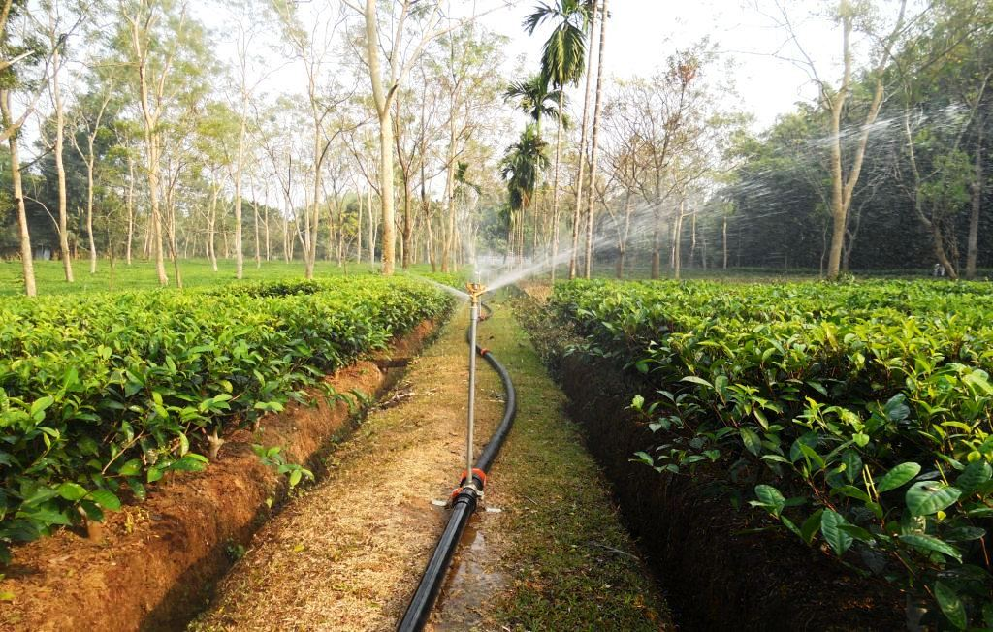
SPRINKLER IN TEA, BONGAIGAON DISTRICT

Slide 25
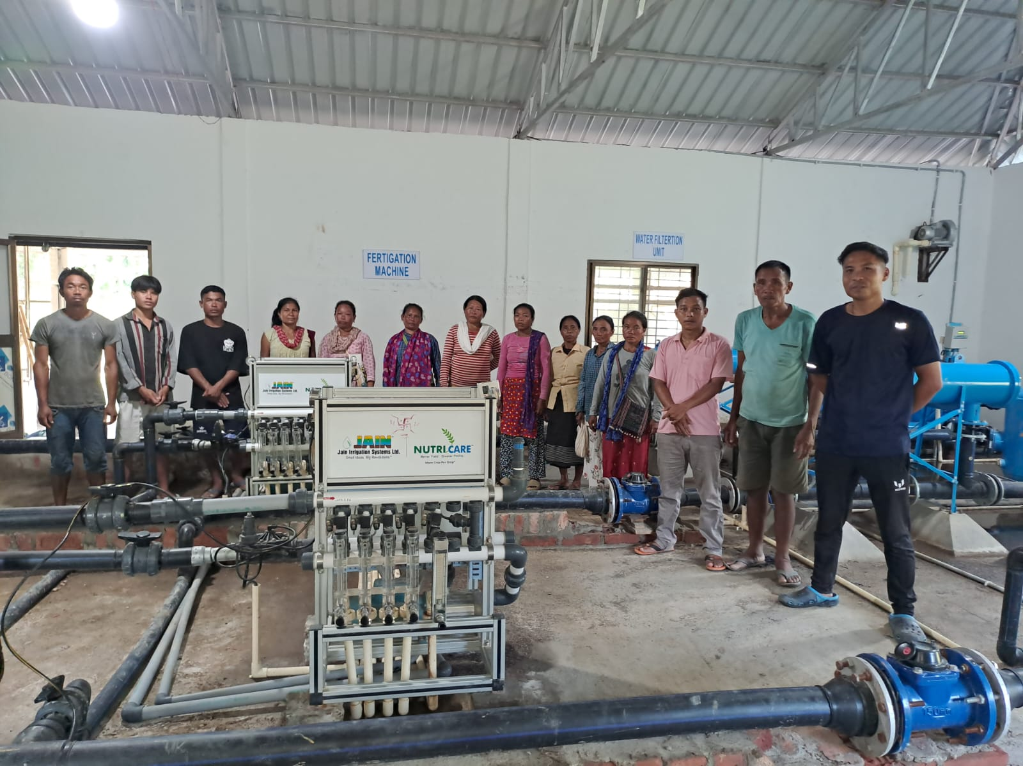
Automation in Tea (200 Ha , 80 Farmers ), Karbi Anglong District

Slide 26
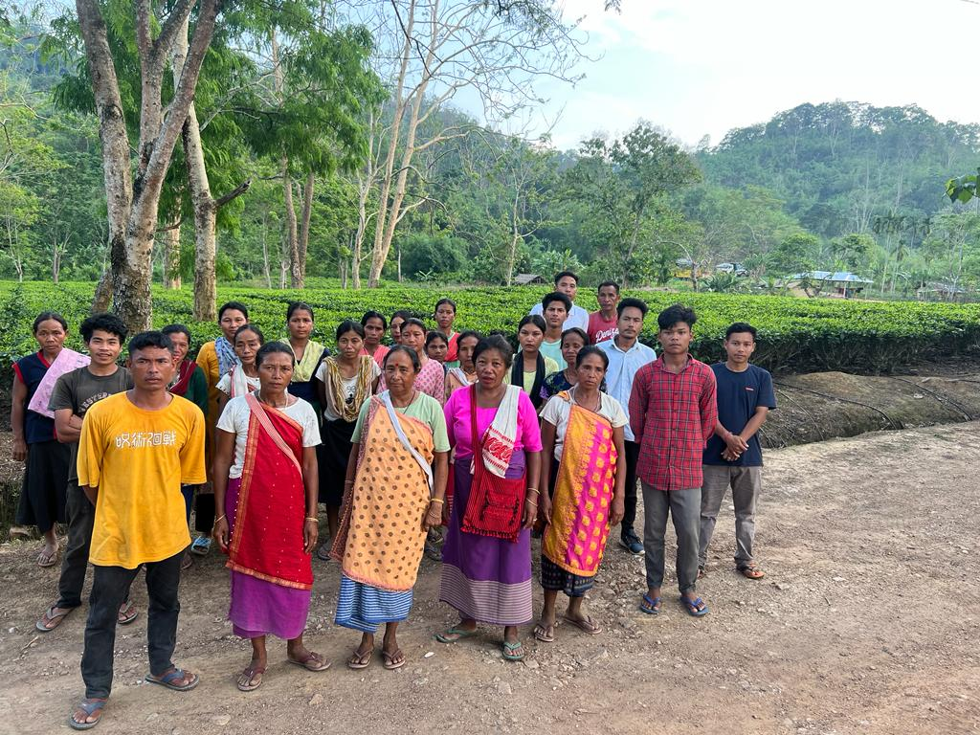
Farmers in their Tea Garden

Slide 27
Drip with Solar Pump, Bongaigaon District

Slide 28
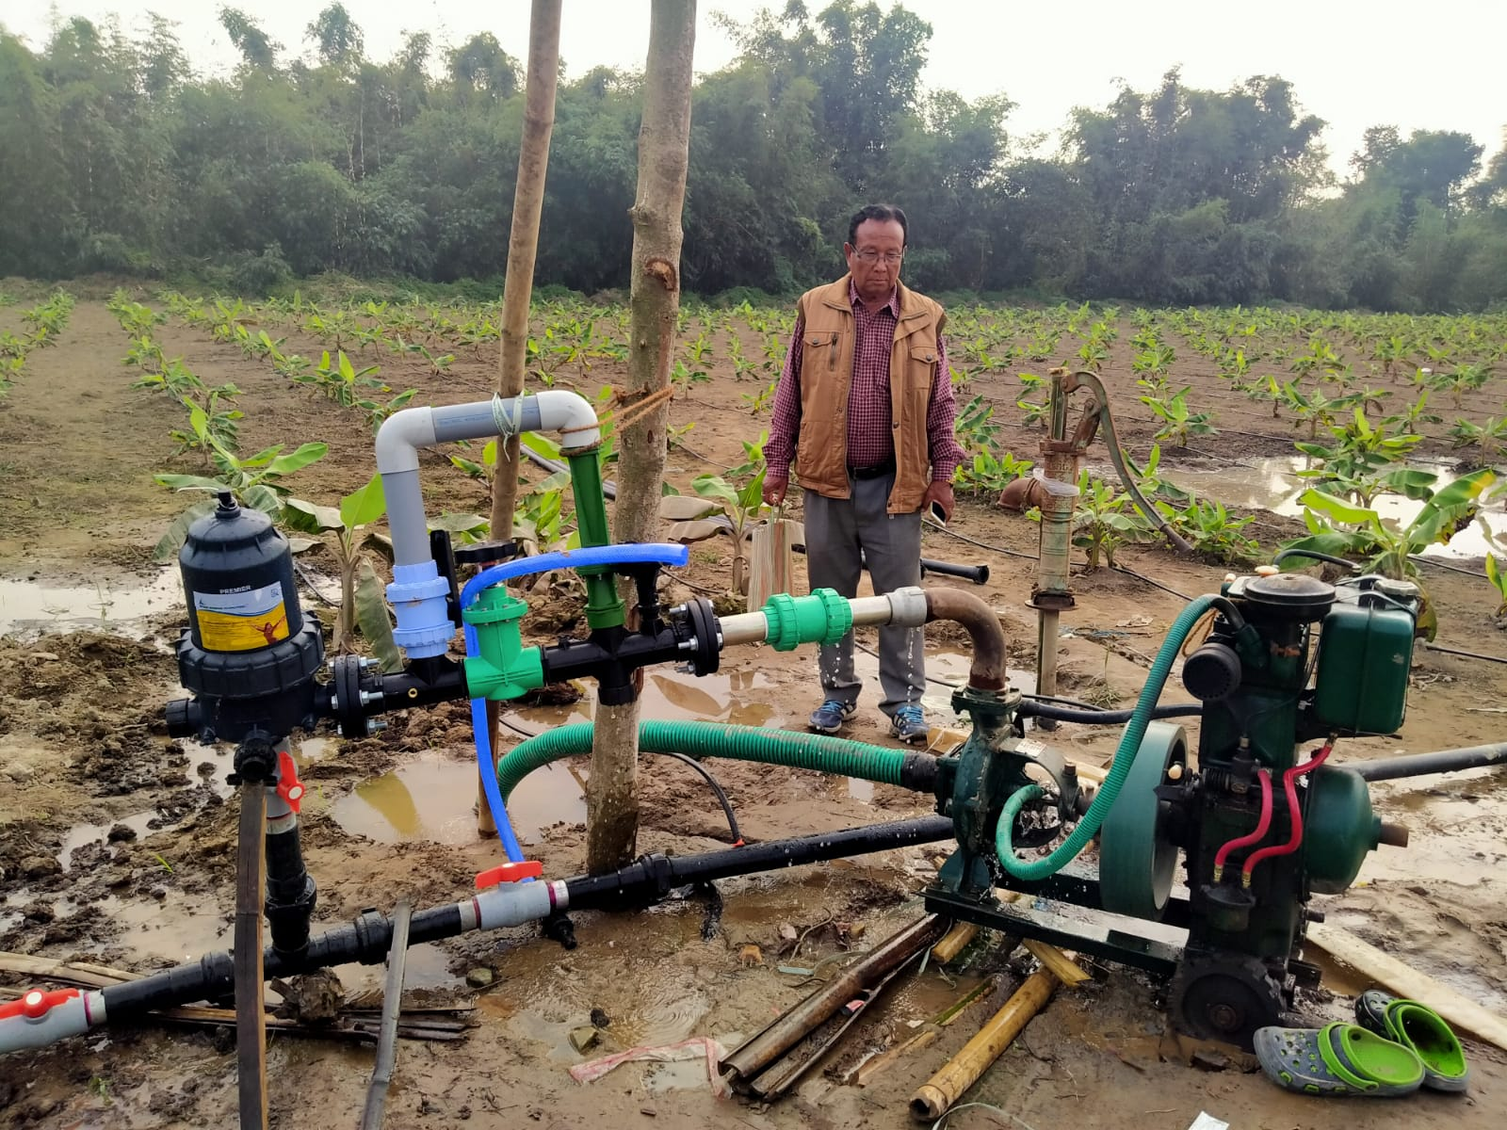
Drip in Cabbage & Banana, Kokrajhar

Slide 29
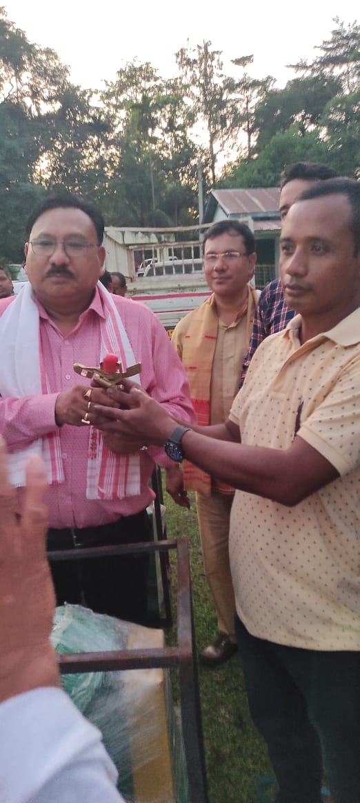
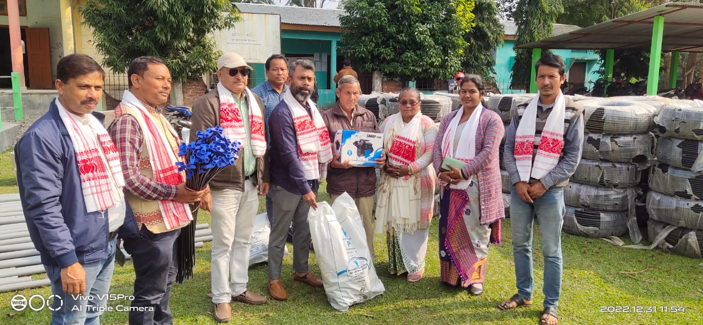
Distribution programme in presence of Ministers & local MLA

Slide 30
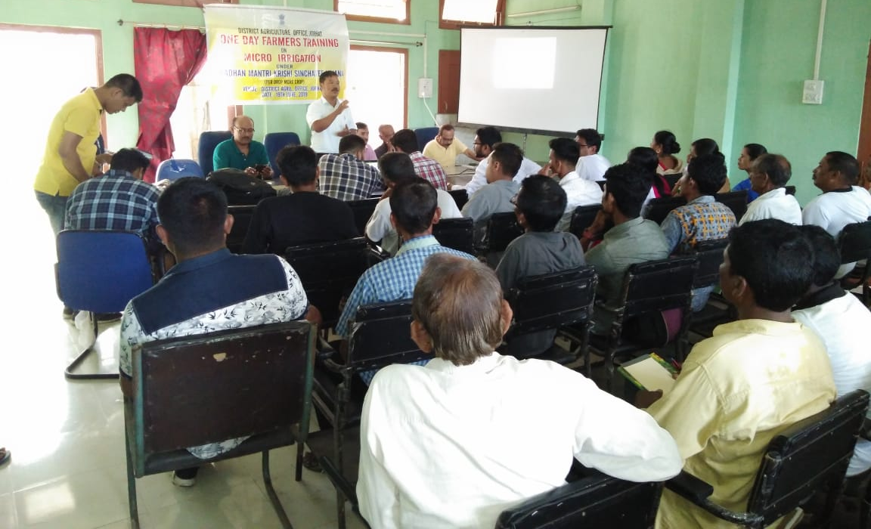
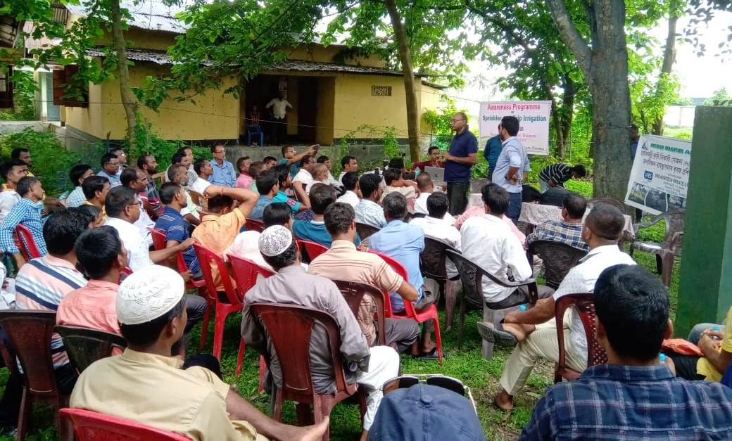
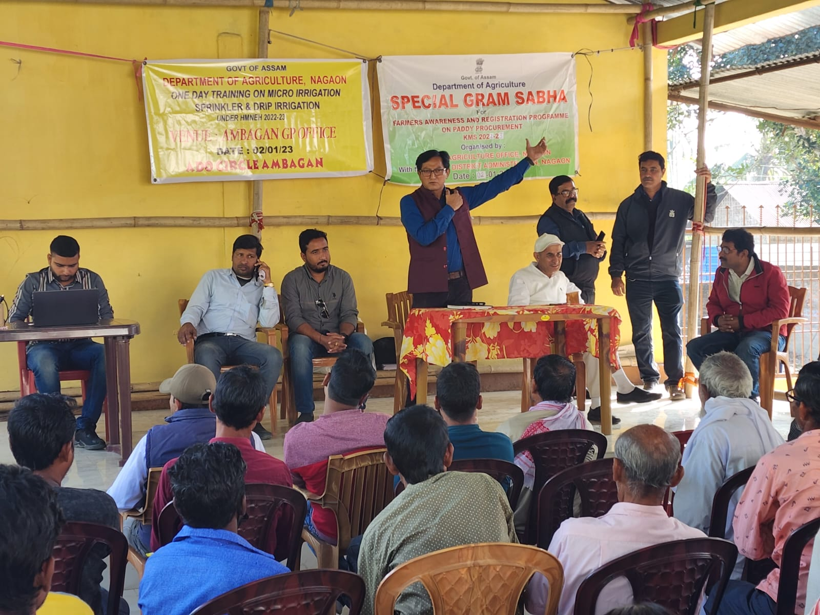
Farmers Training

Slide 31
THANK YOU

